Slide 1


Vibe Consulting – Death of Consultancy or Its New Superpower?
Dr. Alan Warr
13th November 2025

Slide 2

BCS / CONSIG Notices & Announcements
This event will NOT be posted on YouTube

Slide 3

Section 1
Introduction & Viewpoint from the Event

Slide 4
Agenda
Vibe Consulting: The practice of using artificial intelligence to augment consultancy services, where consultants and consultancies integrate AI tools, insights, and automation into their work to enhance analysis, decision-making, client engagement, and delivery of outcomes. Vibe Consulting combines human expertise with AI-driven capabilities to create faster, deeper, and more adaptive consulting interventions.
Where are we now? Recap -> Demo -> Exercise
What is the consultancy industry doing? Research Review (General & Consultancy Specific)
Where are we going? Insights from Research -> Tech Demos
What should WE be doing now? Exercise -> Futures -> Discussion

Slide 5
Welcome from Nestor

Slide 6




Will consultants be replaced by AI?
Growing consensus among industry leaders that generative AI is poised to transform the consulting landscape, particularly by automating routine and procedural tasks.
“Who needs Accenture in the age of AI? …… As semi-autonomous AI agents sweep the world, who needs consultants?” Economist, June 2025
“Deep Research now handles 5% of all economic tasks, performing complex tasks such as product comparison and financial analysis, which were traditionally carried out by highly paid consultants.”
Sam Altman, CEO, OpenAI, February 2025 on Times Tech Podcast.
“AI-driven automation could eliminate up to 50% of jobs in audit, tax, and advisory within three to five years.”
Alan Paton – Former PwC Partner and CEO of Qodea, May 2025 in Business Insider.
“The future of consulting is going to be a hybrid of people plus software, like, a lot of software. I think that consulting companies that can’t do that are going to fall away.”
Mohamad Ali – Head of IBM Consulting, October 2025
Notes:
1.
Sam Altman – CEO of OpenAI
Quote: “Deep Research now handles 5% of all economic tasks, performing complex tasks such as product comparison and financial analysis, which were traditionally carried out by highly paid consultants.”
Date: February 2025
Context: In an interview with The Times Tech Podcast, Altman discussed OpenAI’s latest AI agent, Deep Research, highlighting its capability to perform tasks traditionally done by consultants, signaling a shift in how such services might be delivered in the future.
2.
Alan Paton – Former PwC Partner and CEO of Qodea
Quote: “AI-driven automation could eliminate up to 50% of jobs in audit, tax, and advisory within three to five years.”
Date: May 2025
Context: In an article by Business Insider, Paton warned that AI could disrupt the traditional business models of major consulting firms, particularly affecting roles in audit, tax, and advisory services.
3.
Travis Kalanick – Co-founder of Uber and CEO of City Storage Systems
Quote: “Consultants who merely execute instructions may be replaced by AI… The future of consulting is like: ‘Push a button. Get a consultant.’”
Date: April 2025
Context: Speaking on the Moonshots with Peter Diamandis podcast, Kalanick emphasized that AI threatens traditional consulting roles focused on routine tasks, suggesting a future where AI could handle such responsibilities more efficiently.
These insights reflect a growing consensus among industry leaders that generative AI is poised to transform the consulting landscape, particularly by automating routine and procedural tasks.
Bill Gates – Co-founder of Microsoft
Quote: “AI will replace humans for most things.”
Date: March 2025
Context: In an interview on The Tonight Show, Gates discussed the rapid advancement of AI, suggesting that within a decade, AI could handle the majority of tasks currently performed by humans. While he specifically mentioned professions like doctors and tutors, the implication extends to various knowledge-based roles, including consulting.
Additional Insight: Gates has also predicted a significant reduction in the standard workweek due to AI’s capabilities, envisioning a future where a two-day workweek becomes the norm as AI takes over routine tasks.
2. Mustafa Suleyman – Co-founder of DeepMind and CEO of Inflection AI
Quote: “These are fundamentally labor-replacing tools.”
Date: January 2024
Context: At the World Economic Forum in Davos, Suleyman emphasized that AI technologies, while augmenting human productivity in the short term, are inherently designed to replace labor over the long term. He highlighted the need for careful integration of AI into the workforce to address potential job displacement.
Additional Insight: Suleyman has advocated for viewing AI as tools that should be controlled and contained to ensure they remain beneficial to humanity.
These perspectives from industry leaders underscore the transformative potential of AI in sectors like consulting, where tasks involving data analysis, strategic planning, and routine decision-making are prevalent.

Slide 7
BCS Expert Panel - AI in Consultancy
Innovative Applications:
Generative AI for enhanced client interaction
Predictive analytics for strategic insights
Intelligent automation streamlining processes
Implementation Challenges:
Ethical implications of AI usage
Data privacy and compliance issues
Continuous upskilling requirements
Real-World Impact:
Improved service delivery efficiency
Enhanced client outcomes
Competitive advantage through AI integration
Event by BCS Consultancy & AI Specialist Groups (December 2024)

Slide 8

Live Demo 1 | AI-Enabled DIY Consultancy

Slide 9





Demo: The Threat to Consultancy (& the Opportunity) (1) Obtaining consultancy advice from an AI model rather than a consultant (cheaper, faster, maybe not better)
Person
Problem
AI Model(s)
Advice
Scenario: "We’re a UK mid-market retailer with falling online conversion over the last 3 months. "
"What should we do in the next 90 days to diagnose and fix this?"

Slide 10



Demo: The Threat & the Opportunity (2) Let’s throw the problem at three market leading AI models with no UI and just a simple ask ….
ChatGPT from OpenAI
Advice
Person
Problem
Claude from Anthropic
Advice
Gemini from Google AI
Advice

Slide 11
Advice from ChatGPT
Absolutely, declining online conversion is a critical issue, and acting quickly and systematically is key.
Here’s a **90-day action plan** tailored for a UK mid-market retailer: --- ## **Weeks 1-2: Diagnose the Problem** ### 1. **Data Deep-Dive**
- **Segment Analysis:** Break down conversion by device, channel, traffic source, location, and product category. - **Funnel Analysis:** Identify where drop-offs are happening (homepage, category, product page, basket, checkout). - **Compare to Previous Periods:** Look for changes in user behaviour, traffic quality, or technical performance. ### 2. **Technical Health Check**
- **Site Speed:** Use Google PageSpeed Insights and WebPageTest to check for slowdowns.
- **Error Tracking:** Review error logs, broken links, and 404s. - **Mobile Experience:** Audit mobile usability (common pain point).
### 3. **Competitor Benchmarking** - Review competitors’ sites for new features, promotions, or UX improvements. ### 4. **Customer Feedback** - **On-site Surveys:** Ask recent visitors about their experience and friction points. - **Customer Service Logs:** Review for recurring complaints about the online experience. --- ## **Weeks 3-4: Hypothesis & Quick Wins** ### 1. **Form Hypotheses** - E.g., “Conversion dropped on mobile after a recent site update”, “Competitor pricing is more aggressive”, “Checkout errors increased”. ### 2. **Implement Quick Fixes** - **Fix obvious bugs:** Broken links, error messages, missing images. - **Restore previous high-performing elements** if recent changes correlate with the drop……
..[cut off here for display purposes)

Slide 12
Advice from Claude
……..[cut off here for display purposes)
2. Technical Improvements - Optimize site speed - Enhance mobile experience - Implement performance improvements identified in audit 3. Personalization - Targeted product recommendations - Personalized homepage experiences - Behavioral targeting Month 3: Implementation & Measurement
1. Rollout Validated Improvements
- Implement winning test variations
- Continuous small-scale experiments
- Monitor key conversion metrics
2. Customer Engagement
- Retargeting campaigns
- Personalized email marketing
- Loyalty program enhancements
Recommended Tools:
- Google Analytics
- Hotjar
- Optimizely
- UserTesting.com
Key Metrics to Track:
- Conversion rate
- Average order value
- Cart abandonment rate
- Site speed
Mobile vs desktop performance……
..[cut off here for display purposes)
Here's a structured 90-day plan to diagnose and address falling online conversion rates: Month 1: Diagnostic Phase
1. Data Analysis - Deep dive into web analytics - Segment conversion drop by: - Device type - Traffic source - Product categories - Customer demographics 2. Technical Audit - Site speed testing - Mobile responsiveness check - Checkout flow analysis - Performance across browsers/devices 3. User Experience Research - Heatmap and session recording tools - User testing sessions - Customer feedback surveys - Abandoned cart analysis Month 2: Hypothesis & Initial Testing 1. Conversion Optimization - A/B test checkout process - Simplify form fields - Improve product page layouts
- Enhanced product imagery/videos - Clearer pricing/shipping information

Slide 13
Advice from Gemini
……..[cut off here for display purposes)
This is a critical situation for a mid-market retailer, as online conversion directly impacts revenue. A 90-day plan needs to be structured, data-driven, and action-oriented, focusing on both diagnosis and rapid implementation of fixes.
Here's a comprehensive 90-day plan:
---
## 90-Day Plan: Diagnosing & Fixing Falling Online Conversion
**Goal:** Understand the root causes of the conversion drop and implement targeted fixes to reverse the trend within 90 days.
**Key Principle:** Data-driven decisions. Avoid assumptions.
---
### Phase 1: Diagnose & Prioritise (Weeks 1-4)
**Objective:** Identify *what* is happening, *where* it's happening, and *why*.
**Week 1: Data Deep Dive & Technical Audit**
1. **Analytics Review (Google Analytics 4 - GA4):**
* **Conversion Funnel Analysis:** Pinpoint the exact stage where users are dropping off (e.g., product page to cart, cart to checkout, checkout steps). Compare current vs. previous 3 months.
* **Traffic Source Performance:** Are specific channels (e.g., paid search, social, organic, email) seeing a disproportionate drop in conversion? Or is it across the board? This indicates traffic quality issues vs. site issues.
* **Device Performance:** Is the drop more pronounced on mobile, tablet, or desktop?
* **Page Performance:** Identify high-exit pages, high-bounce pages, and pages with significant drop-offs before conversion.
* **User Demographics/Geographics:** Any shifts in audience that might explain the change?
* **Site Search Analysis:** What are users searching for? Are they finding it? High "no results" searches?
* **Key Metrics:** Track conversion rate, average order value (AOV), bounce rate, exit rate, time on site, pages per session. ……..[cut off here for display purposes)

Slide 14



Buzz Group Exercise
Share where you are on using AI within your own consulting work and when working with other consultants?
If on Zoom: Contribute into the “Chat” area - reading and building on others.
If in room: Organise into convenient small groups. Check around you that no-one is left out. Discuss.
Please don’t share confidential information!

Slide 15
Section 2
Where is business & consultancy with AI enablement

Slide 16


The Coming Wave
“It’s (AI) not just a tool or platform but a transformative meta technology, the technology behind technology and everything else, itself a maker of tools and platforms, not just a system but a generator of systems of any, and all kinds. Step back and consider what’s happening on the scale of a decade or a century. We really are at a turning point in the history of humanity.”
- Mustafa Suleyman, Co-founder of DeepMind and current CEO of Microsoft AI
Suleyman, Mustafa, with Michael Bhaskar. The Coming Wave: Technology, Power, and the Twenty-First Century's Greatest Dilemma. Crown, 2023.

Slide 17
The Top 10 Gen AI Use Cases
Source: HBR, “How People Are Really Using Gen AI in 2025” by Marc Zao-Sanders April 9, 2025.

Slide 18
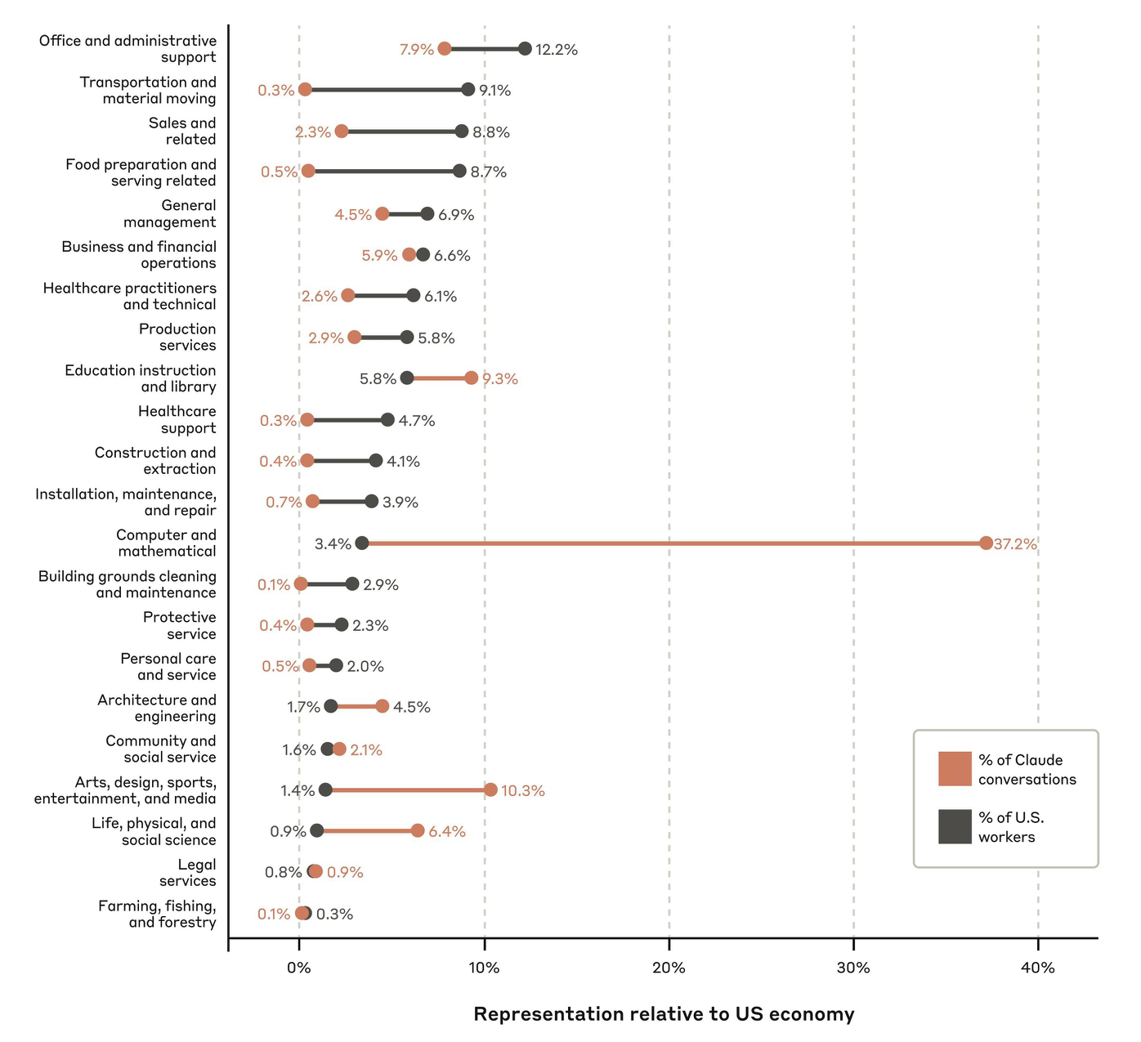
Anthropic measurement of usage by job type
For each job type, the percentage of relevant conversations with Claude is shown in orange compared to the percentage of workers in the U.S. economy with that job type (from the U.S. Department of Labor’s O*NET categories) in grey.
Source: Which Economic Tasks are Performed with AI? Evidence from Millions of Claude Conversations.
Handa, K., et al. arXiv:2503.04761.

Slide 19
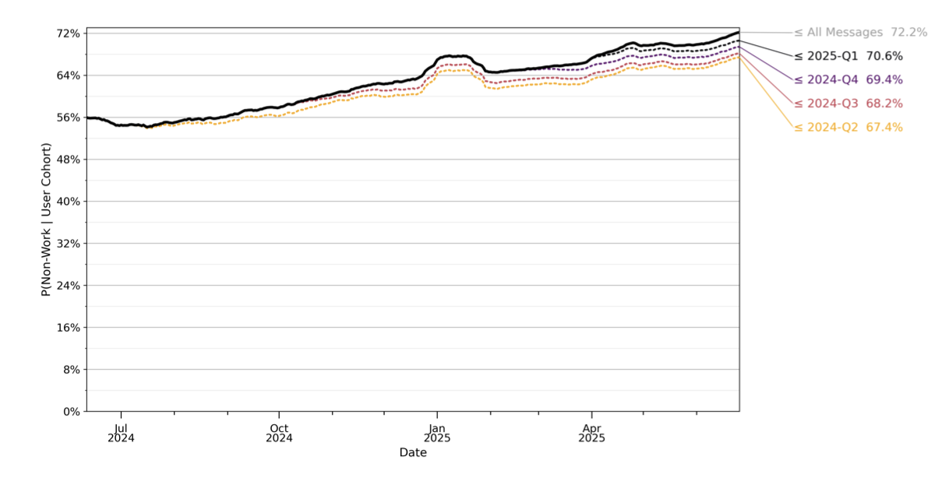
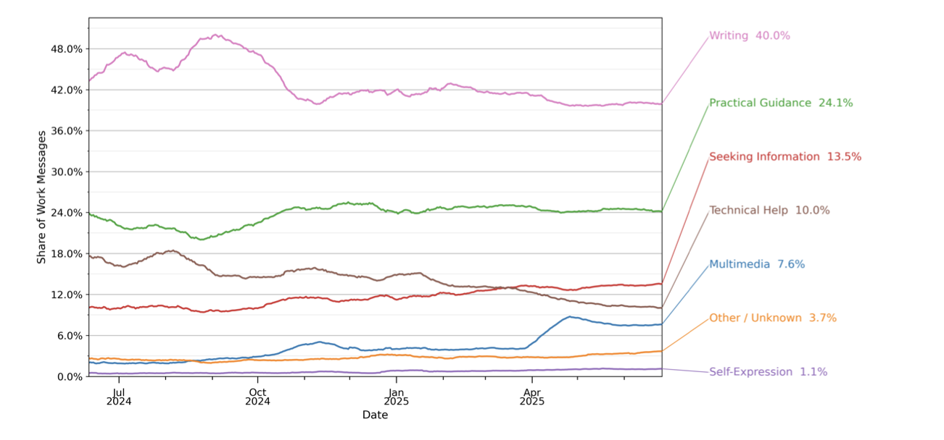
OpenAI ChatGPT Consumer Usage for Work
How People Use ChatGPT by Chatterji, A. et al., NBER Working Paper, September 2025.

Slide 20

McKinsey’s Global AI Survey Found 1% of AI Initiatives in Global Corporations Generating Value! 1500 corporates > $500m in revenues surveyed in mid 2024
“Organizations have been experimenting with gen AI tools. Use continues to surge, but from a value capture standpoint, these are still early days—few are experiencing meaningful bottom-line impacts.
Larger companies are doing more organizationally to help realize that value. They invest more heavily in AI talent. They mitigate more gen-AI-related risks. We have seen organizations move since early last year, and the technology also continues to evolve, with a view toward agentic AI as the next frontier for AI innovation.”
https://www.mckinsey.com/capabilities/quantumblack/our-insights/the-state-of-ai#/

Slide 21
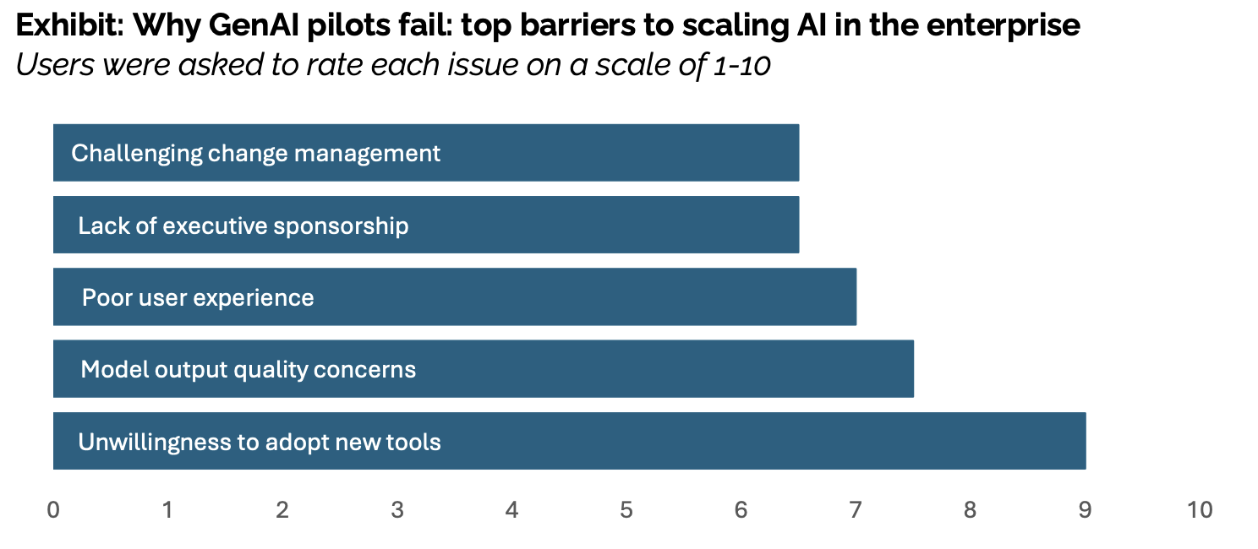
MIT survey on failing Applied AI projects in corporates 300+ initiative reviews, 52 interviews, and 153 survey responses
“Just 5% of integrated AI pilots are extracting millions in value, while the vast majority remain stuck with no measurable P&L impact. This divide does not seem to be driven by model quality or regulation but seems to be determined by approach……..
Organizations on the right side of the GenAI Divide share a common approach: they build adaptive, embedded systems that learn from feedback……..Domain fluency and workflow integration matter more than flashy UX.”
Source: The GenAI Divide: State of AI in Business 2025, by MIT NANDA, Challapally, et al. September 2025.
Notes:
Methodology: 52 structured interviews across enterprise stakeholders, systematic analysis
of 300+ public AI initiatives and announcements, and surveys with 153 leaders. Success
defined as deployment beyond pilot phase with measurable KPIs. ROI impact measured 6
months post-pilot, adjusted for department size. Confidence intervals calculated using
bootstrap resampling methods where applicable.

Slide 22
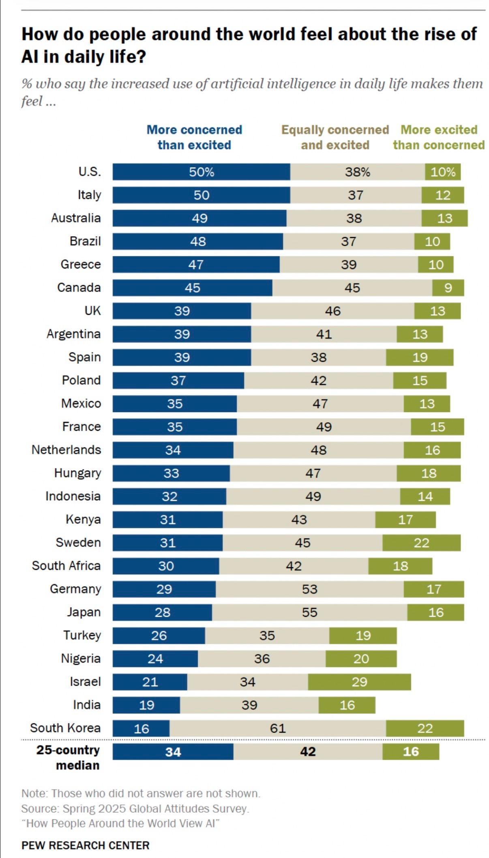
People are Aware, but Cautious and Divided

Slide 23

Case: JP Morgan
Investing in AI since 2012 (originally with Palantir)
Spending $2 bn and now breaking even (out of £18bn on tech)
Reports to CEO
Hardest part was getting business to understand what AI can do
Own platform (OmniAI) across 300,000 employees in 100 companies
> 450 active AI use cases
6000 money movements per second by AI
AI prevents $1.5bn of fraud
200,000 analysing proprietary data …….
Jamie Dimon, Chairman & CEO of JP Morgan Chase
Source: Databricks Conference, June 2025 https://youtu.be/0hT-FJ7Ay4Y?si=St1JPfEaiPjkMfrh

Slide 24
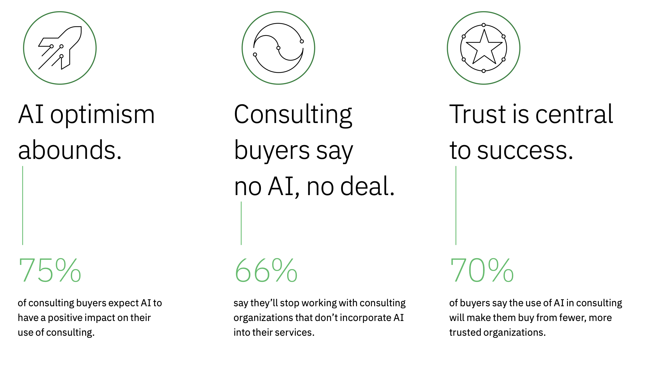
IBM survey on AI and consultancy
400 C-level executives across 14 industries and 6 countries from June to August 2024
Source: Consulting reimagined, powered by AI, by IBM Institute for Business Value, October 2024.

Slide 25
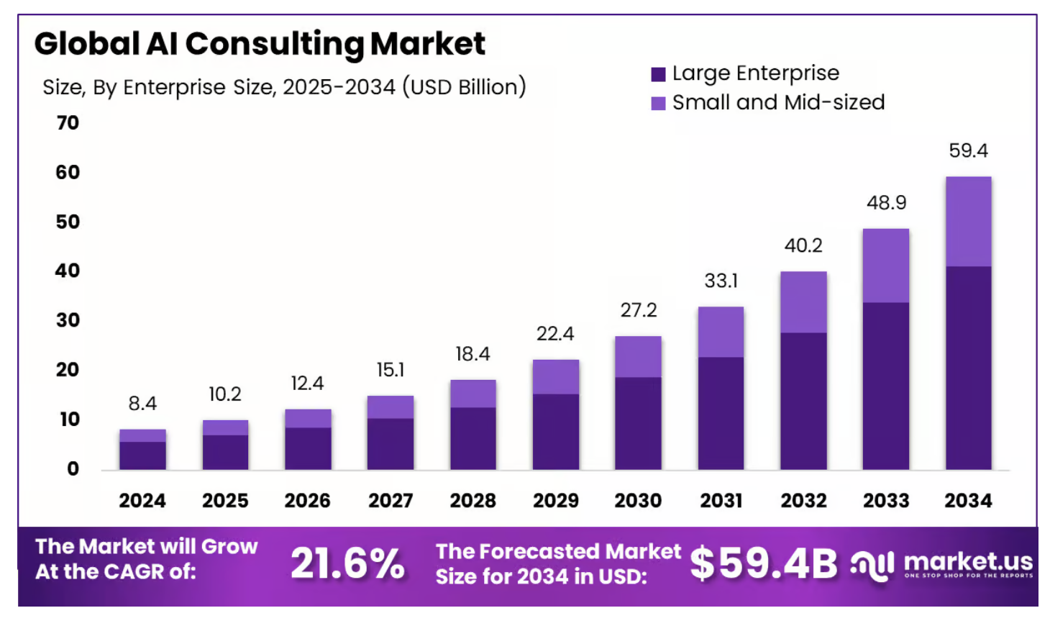
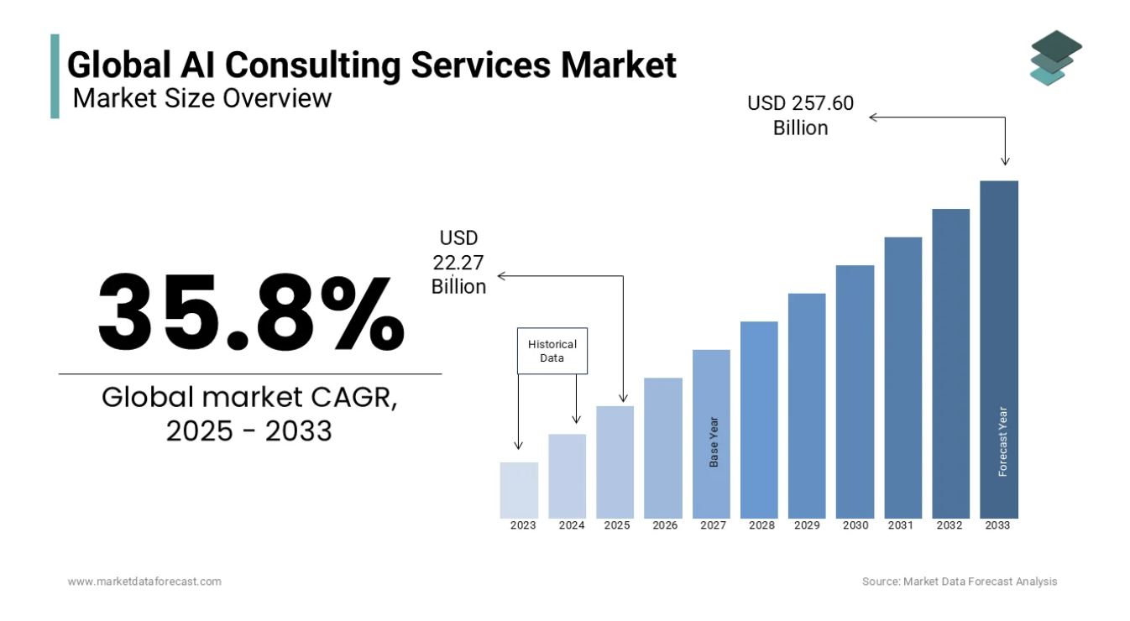
Global AI consultancy revenues
Source: Market.US
Source: Market Data Forecast

Slide 26

AI Revenues Look to be Increasing within Big-4
No firm breaks out AI revenue separately in statutory or global press releases; AI work is embedded inside consulting/tech/transformation lines (and sometimes managed services/products).
“In FY25, AI-related revenue grew by 30% – ranging from delivering enterprise-wide transformations to AI governance frameworks that help drive the responsible implementation of AI. More than 15,000 EY people worked on AI-led projects for clients in the Consulting and EY-Parthenon Service Lines.”
Source: https://www.ey.com/en_gl/newsroom/2025/10/ey-announces-global-revenue-of-us-53-2b-for-fiscal-year-2025

Slide 27

AI-Enabled Consulting can Deliver Errors to Clients
Big 4 created report for Australian government
> 200k fees
20 errors found by client from using AI that made up quotes and references (hallucination)
Led to republication and refund
Senator Deborah O’Neill from the Australian Labor Party “Perhaps instead of a big consulting firm, procurers would be better off signing up for a ChatGPT subscription,”
Source

Slide 28
Section 3
Case-based review of what consultancies are doing with AI

Slide 29
Types of Consultancies in Focus
Strategy Houses (e.g. McKinsey)
Big-4 (e.g. KPMG)
IT Services (e.g. Accenture)
AI-powered Challengers

Slide 30
Participants’ Exercise
As we look at what’s happening across our industry pay particular attention to what you could be doing either directly or by adapting it to something better?

Slide 31
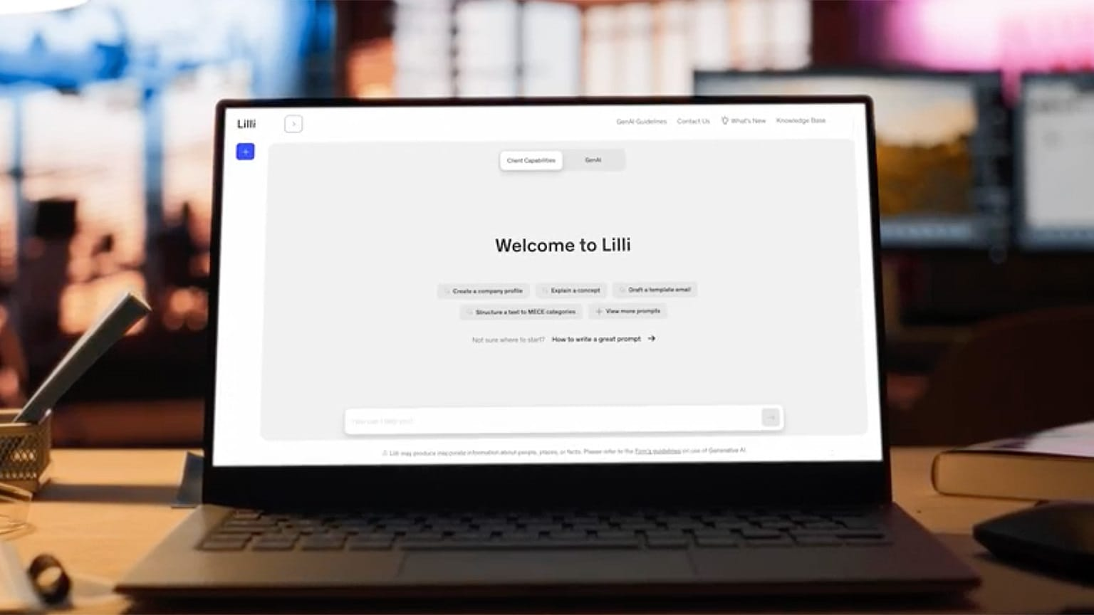
Notes:
- Meet Lilli: McKinsey’s Generative AI Tool (mckinsey.com https://www.mckinsey.com/about-us/new-at-mckinsey-blog/meet-lilli-our-generative-ai-tool
- Rewiring McKinsey with Lilli (mckinsey.com). https://www.mckinsey.com/capabilities/mckinsey-digital/how-we-help-clients/rewiring-the-way-mckinsey-works-with-lilli
- Lessons from Building Lilli (mckinsey.com). https://www.mckinsey.com/capabilities/mckinsey-digital/our-insights/what-mckinsey-learned-while-creating-its-generative-ai-platform?hsid=44cf8331-b5e2-4795-a1a1-eb40d60290d1

Slide 32




Quotes from McKinsey Leaders
“My hope is the future McKinsey consultant, and perhaps broader to the industry as well, will actually spend more time activating their insights as opposed to doing the analytics to create them.”
- Erik Roth, Creator of Lilli & Senior Partner
“With Lilli, we can use technology to access and leverage our entire body of knowledge and assets to drive new levels of productivity.”
- Jacky Wright, Senior Partner and CIO
“Lilli has unleashed creative potential.”
- Phil Hudelson, Partner & CTO
“We almost have AI in the room with us.”
Delphine Zurkiya, Senior Partner
Notes:
McKinsey & Company has strategically integrated artificial intelligence (AI) into its internal operations and client services, positioning itself as a leader in the evolving consulting landscape.
🧠 Internal Adoption of AI at McKinsey
To enhance consultant productivity and streamline workflows, McKinsey developed "Lilli," an in-house generative AI chatbot. Trained on over 100 years of the firm's knowledge, encompassing more than 100,000 documents and interviews, Lilli assists consultants in research, data analysis, and problem-solving. Since its rollout in 2023, over 70% of McKinsey's 45,000 employees have adopted Lilli, with users engaging the tool approximately 17 times per week. The firm reports that Lilli has enabled consultants to save about 30% of their time on various tasks. LinkedIn+2Business Insider+2LinkedIn+2
Beyond Lilli, McKinsey empowers consultants to build custom AI agents tailored to specific tasks. These agents, along with domain-specific tools in areas like life sciences, support consultants in rapidly understanding sector-specific information and client needs. LinkedIn+2Business Insider+2LinkedIn+2
🤖 AI Services Offered to Clients
McKinsey extends its AI expertise to clients through QuantumBlack, its AI consulting arm established following the 2015 acquisition of a data analytics and design company. QuantumBlack employs approximately 7,000 tech experts across 50 countries. The firm has completed over 400 generative AI projects for clients, developing solutions that include predictive analytics, AI-driven market analysis, and customized AI tools. Business Insider
McKinsey's approach emphasizes helping clients integrate AI into their operations effectively. This includes advising on data infrastructure readiness, fostering an innovative culture, and redesigning business models to leverage AI capabilities fully. Business Insider+1Medium+1
📈 Impact on Revenue and Growth
While specific revenue figures for 2024 have not been disclosed, McKinsey reported $16 billion in revenue for 2023. The firm acknowledges that generative AI enables new levels of productivity for its teams. Reddit+3The Times+3Business Insider+3Financial Times
McKinsey's research estimates that generative AI could add between $2.6 trillion to $4.4 trillion annually in productivity growth across various industries. The firm is actively working with clients to capture this potential by integrating AI into their operations. McKinsey & Company+2McKinsey & Company+2McKinsey & Company+2
🗣️ Leadership Perspectives
McKinsey's leadership views AI as a transformative force in consulting. Bob Sternfels, McKinsey's Global Managing Partner, has initiated a "rewire" of the company to modernize governance and improve internal structures, emphasizing the need for high-value consulting services in the AI era. MediumFinancial News London+1Financial Times+1
Shelley Stewart, a senior partner, highlighted the firm's shift from merely offering strategic ideas to actively helping clients implement changes, stating, "What we do is we effect change: change in results, change in capabilities." Financial News London
In summary, McKinsey & Company's integration of AI into its operations and client services underscores its commitment to innovation and adapting to the evolving consulting landscape. Through tools like Lilli and its AI consulting arm, QuantumBlack, McKinsey is enhancing productivity and delivering significant value to clients, positioning itself at the forefront of AI-driven transformation in the consulting industry.

Slide 33
Case: McKinsey’s “Lilli”
Lilli
Usage by McKinsey Consultants
Lilli is McKinsey's proprietary generative AI platform.
Named after Lillian Dombrowski.
Launched in 2023.
Designed to enhance consultants' efficiency by providing rapid access to firm-wide knowledge.
Access internal knowledge (100,000+ documents).
Identify subject matter experts.
Develop client-ready materials.
Brainstorm and generate insights.
Impact and Benefits
Strategic Significance
Lessons Learned
Used by 70%+ of employees (~17 uses/week).
Saves up to 30% time in information gathering.
Processes 500,000+ prompts/month.
Streamlines workflows and increases productivity.
Integrates internal and external data.
Provides tailored insights for client contexts.
Enhances collaboration through expert connections.
Represents a major shift in knowledge management.
Prompts matter a lot.
Be vigilant about data curation
Invest in an orchestration layer
Test and test again and again
Its never just tech

Slide 34
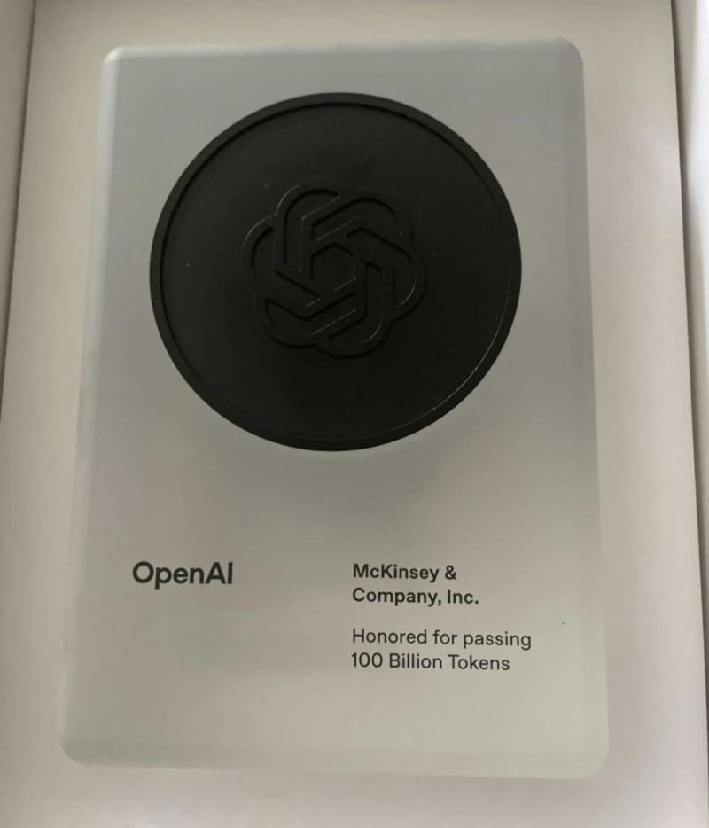
Passing 100 Billion Tokens on OpenAI Tech

Slide 35

Lillian Dombrowski: The Inspiration Behind Lilli
• Lillian Dombrowski was McKinsey’s first professional female hire in 1945.
• Served for 35 years as an accountant, controller, and corporate secretary.
• Key contributions:
- Reformed financial systems
- Provided analytical support to consultants
- Helped develop profit-sharing and pension plans
- Organized McKinsey’s historical archives
• McKinsey’s AI platform 'Lilli' honours her legacy:
- Like Lillian, Lilli aggregates and organizes knowledge
- Empowers consultants with fast, insightful information
- Embodies her pioneering, adaptable spirit
• Quote: 'Lilli was selected because the platform is as nimble, flexible, and thorough, as she was.'

Slide 36
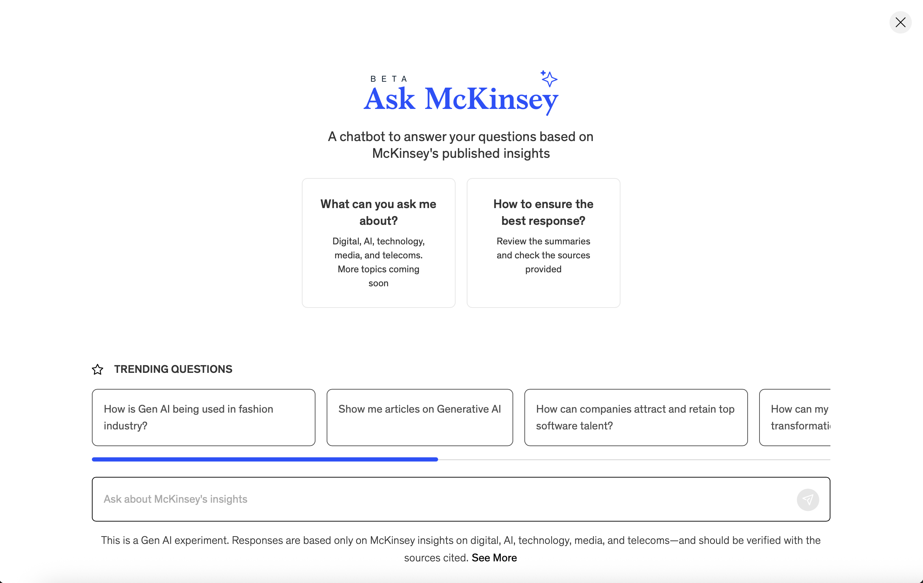
Ask McKinsey!
Source: https://www.mckinsey.com/features/ask-mckinsey?cid=other-eml-alt-mip-mck&hlkid=baad510143c24d918432caf08cff703b&hctky=2182130&hdpid=5c430f42-8bd0-4b02-a31e-7519aee08fa9#ask-mckinsey

Slide 37
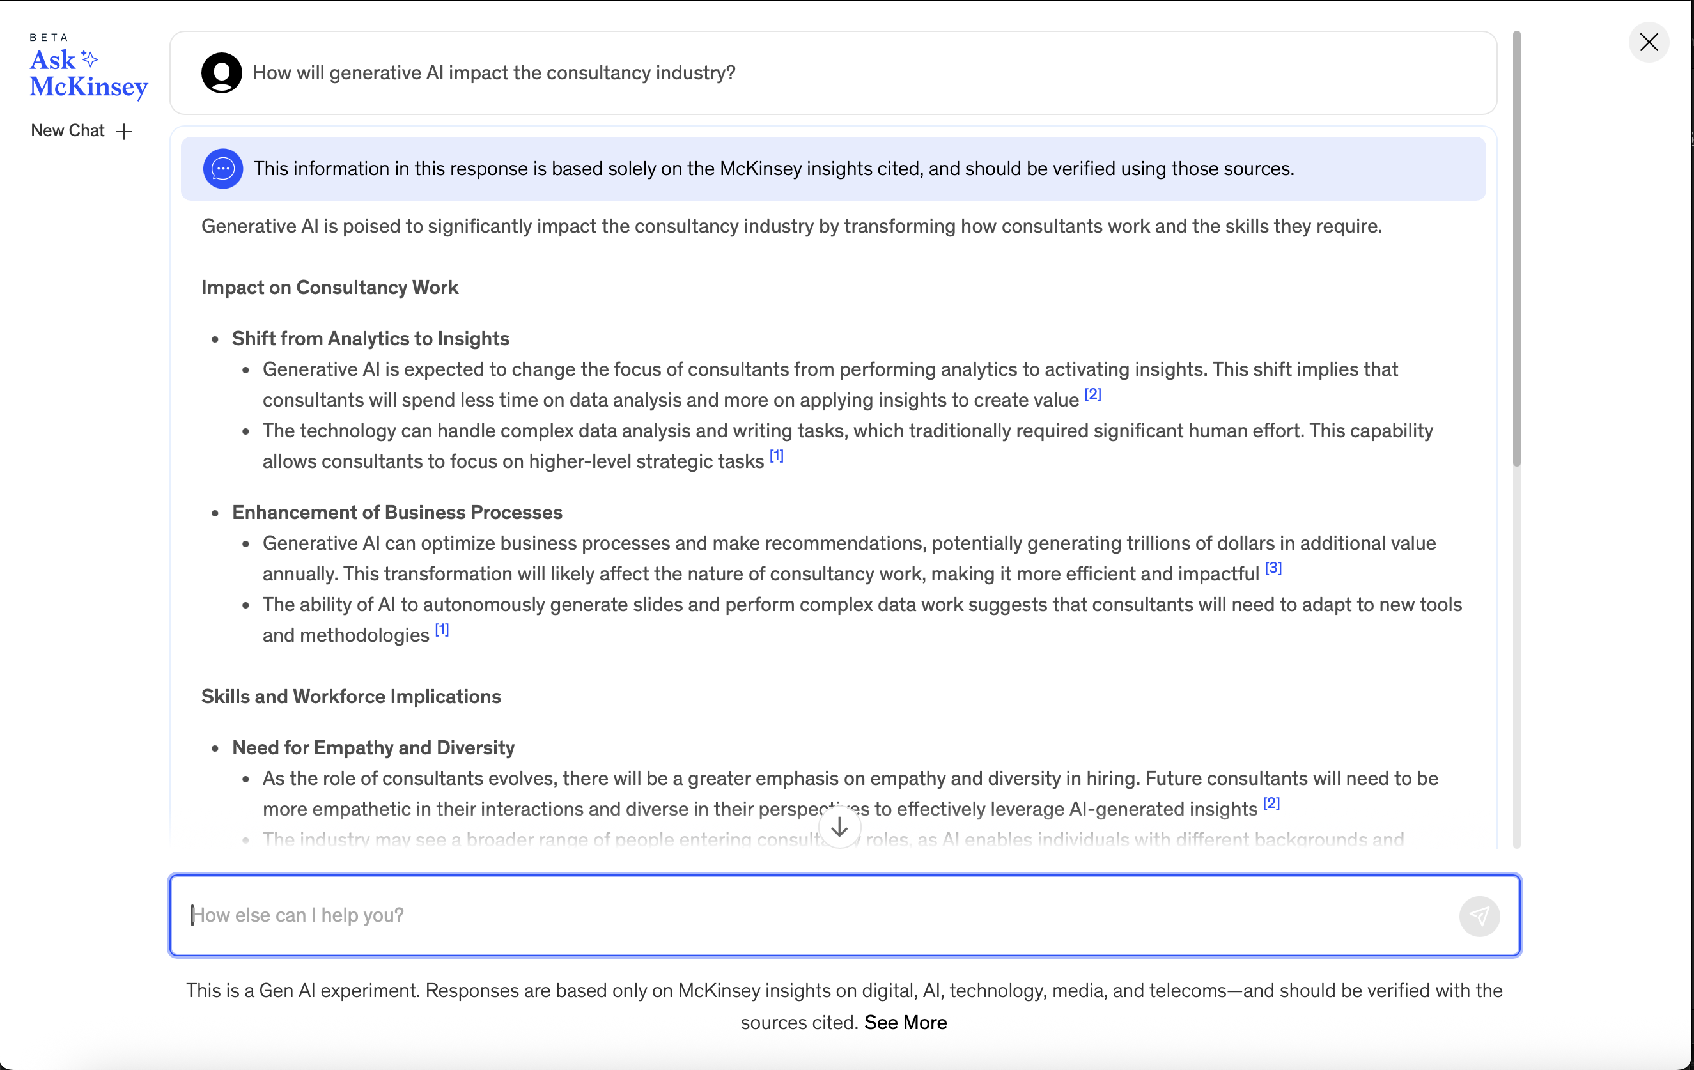
How will generative AI impact the consultancy industry?
Notes:
Generative AI is poised to significantly impact the consultancy industry by transforming how consultants work and the skills they require.
Impact on Consultancy Work
Shift from Analytics to Insights
Generative AI is expected to change the focus of consultants from performing analytics to activating insights. This shift implies that consultants will spend less time on data analysis and more on applying insights to create value ^{[2]}
The technology can handle complex data analysis and writing tasks, which traditionally required significant human effort. This capability allows consultants to focus on higher-level strategic tasks ^{[1]}
Enhancement of Business Processes
Generative AI can optimize business processes and make recommendations, potentially generating trillions of dollars in additional value annually. This transformation will likely affect the nature of consultancy work, making it more efficient and impactful ^{[3]}
The ability of AI to autonomously generate slides and perform complex data work suggests that consultants will need to adapt to new tools and methodologies ^{[1]}
Skills and Workforce Implications
Need for Empathy and Diversity
As the role of consultants evolves, there will be a greater emphasis on empathy and diversity in hiring. Future consultants will need to be more empathetic in their interactions and diverse in their perspectives to effectively leverage AI-generated insights ^{[2]}
The industry may see a broader range of people entering consultancy roles, as AI enables individuals with different backgrounds and experiences to contribute effectively ^{[2]}
Human Oversight and Adaptation
Despite the capabilities of generative AI, human oversight remains crucial. Consultants must be involved in guiding AI applications and correcting outputs to ensure accuracy and relevance ^{[1]}
There is a need for consultants to adapt to the rapid pace of AI development and address emerging risks, such as intellectual property concerns and the quality of AI-generated content ^{[3]}
Conclusion
Generative AI is set to transform the consultancy industry by shifting the focus from analytics to insights, enhancing business processes, and necessitating new skills and diversity in the workforce. However, human oversight and adaptation to emerging risks remain essential. This analysis is based solely on insights published by McKinsey.
Citations: 1. https://www.mckinsey.com/mgi/forward-thinking/forward-thinking-on-the-brave-new-world-of-generative-ai-with-ethan-mollick
2. https://www.mckinsey.com/capabilities/mckinsey-digital/our-insights/what-mckinsey-learned-while-creating-its-generative-ai-platform
3. https://www.mckinsey.com/capabilities/mckinsey-digital/our-insights/the-economic-potential-of-generative-ai-the-next-productivity-frontier

Slide 38


Case: AI at Boston Consulting Group (BCG)
"It gets into the crux of our business, right? And it's going to be fundamental to the toolkit and skills that we need to have." “50% of what we do, will be done by clever prompts.”
Vlad Lukic Managing Director & Senior Partner; Global Leader, Tech and Digital Advantage
Forbes, 2024. https://www.forbes.com/sites/bernardmarr/2024/07/10/how-bcg-is-revolutionizing-consulting-with-ai-a-case-study/
Notes:
Boston Consulting Group (BCG) has strategically integrated artificial intelligence (AI) into its operations and client services, positioning itself as a leader in AI-driven consulting.
🧠 Internal Use of AI at BCG
BCG has embedded AI tools across its workforce to enhance productivity and innovation:
Custom GPTs: Employees have developed over 18,000 tailored GPTs for tasks like document summarization and HR inquiries. Business Insider
Deckster: An AI-powered slide creation tool trained on hundreds of templates, aiding consultants in efficient presentation development. Business Insider
GENE: A conversational AI chatbot built on GPT-4o, used for brainstorming, content creation, and client engagement. Business Insider
Navi: An internal chatbot that navigates BCG's knowledge systems, assisting with decision-making processes. Australian Financial Review
These tools have enabled employees to reinvest approximately 70% of time saved into higher-value activities. Business Insider
🤖 AI Services Offered to Clients
BCG provides a range of AI services to clients through its tech division, BCG X:LinkedIn+2BCG Global+2BCG Global+2
AI Agents: Autonomous systems that observe, plan, and act to optimize business processes. For instance, a shipbuilding company reduced engineering resources by 45% using AI agents. BCG Global+1BCG Global+1
AgentKit: An open-source toolkit developed by BCG to build and implement AI agents, used in over 30 projects. BCG Global
Responsible AI Consulting: BCG assists organizations in executing strategic approaches to responsible AI through tailored programs. BCG Global+1BCG Global+1
📈 Impact on Revenue and Growth
AI has become a significant revenue driver for BCG:
In 2024, AI-related services accounted for 20% of BCG's total revenue, amounting to $2.7 billion. Technology Magazine
The firm reported a 10% global revenue growth in 2024, reaching $13.5 billion. Financial News London+2LinkedIn+2PR Newswire+2
CEO Christoph Schweizer noted, "Clients are rapidly shifting from AI exploration to full-scale implementation—unlocking new levels of productivity, speed, and growth." PR Newswire+3Financial News London+3LinkedIn+3
🗣️ Leadership Perspectives
BCG leaders emphasize the transformative potential of AI:
Alicia Pittman, Global People Team Chair, highlighted that over 70% of BCG's 35,000 employees actively use generative AI, fostering innovation and efficiency. Business Insider
Steven Mills, Chief AI Ethics Officer, stressed the importance of responsible AI use, stating, "Responsible AI doesn’t just mitigate risk; it can also increase innovation and productivity." BCG Global
In summary, BCG's integration of AI into its operations and client services has not only enhanced internal productivity but also significantly contributed to revenue growth, solidifying its position as a leader in AI-driven consulting.

Slide 39
Case: BCG’s Enterprise GPT
Enterprise GPT
Usage by BCG Consultants
Rolled out to all BCG staff.
Ensures all data remains within BCG.
Outputs are constrained to the client project.
Enterprise GPTs and consultants can create their own GPTs.
Over 3000 GPTs developed.
Mix of enterprise consulting GPTs, corporate support function GPTs and personal GPTs.
Gene is a versatile tool for client engagement and content creation.
Impact and Benefits
Strategic Significance
Lessons Learned
Speed and productivity benefits.
AI is taking over routine consulting tasks.
Consultants can go deeper with their analyses and insights.
In 2024, AI-related services accounted for 20% of BCG's total revenue, amounting to $2.7 billion.
Cornerstone of BCG’s AI strategy.
Top-down development for enterprise use cases.
Bottom-up for innovations by individuals.
Led by senior partner task force for corporate AI apps and general AI apps for consulting workflows
Formally measured impact on 750 staff.
For straightforward tasks, productivity increased by 30-40% for new hires and 20-30% for experienced consultants.
For complex tasks, productivity sometimes decreased due to the challenges of debugging AI-generated outputs.

Slide 40


Case: AI at Bain
Chuck Whitten, Bain’s Global Head of Digital, highlights the importance of integrating AI into core business functions, stating that companies should pursue a dual-track approach: balancing large-scale, transformative initiatives with incremental improvements.
Christophe De Vusser, Bain's Worldwide Managing Partner and CEO, notes the shift from experimentation to practical application of AI, emphasizing the need for businesses to assess their data readiness and the tangible results AI investments can yield.
Notes:
Internal Adoption of AI at Bain
Bain has embraced AI across its global workforce, providing all 18,000 employees access to AI tools. Notably, within two weeks of introducing ChatGPT Enterprise, 60% of consultants and expert delivery teams adopted the tool, utilizing it to expedite tasks that previously required hours or days. This rapid adoption has enabled consultants to focus more on delivering strategic insights to clients. Bain+1WSJ+1
Beyond ChatGPT, Bain has implemented various AI-powered tools, including Microsoft Copilot, to enhance productivity by automating routine tasks, drafting content, and summarizing insights across the Microsoft Office suite. Proprietary tools like the Expert Call Guide Draft Generator assist in creating interview guides, while other tools categorize datasets and perform sentiment analysis. Bain
🤖 AI Services Offered to Clients
Bain's AI consulting services span multiple industries, offering tailored solutions such as:
Financial Services: Deployment of customer service chatbots, intelligent assistants for wealth advisors, and personalized marketing content generation.Bain
Telecom and Media: Automation of contact centers, intelligent network engineer assistants, and AI-generated media content.Bain
Retail: Implementation of e-commerce content generation, analytics, and intelligent assistants for store operations.Bain
Healthcare: AI-driven communication tools for clinical development, compliance document generation, and intelligent assistants for sales representatives and clinicians. Bain
A notable collaboration is with The Coca-Cola Company, where Bain facilitated the "Create Real Magic" campaign, integrating ChatGPT and DALL·E to engage consumers through AI-generated content. Bain
Furthermore, Bain has expanded its partnership with OpenAI to develop industry-specific AI solutions. This includes tools for retail, such as AI-based shelf and space planning, and for life sciences, like automated document creation. Bain has equipped 13,000 consultants with ChatGPT Enterprise licenses to support these initiatives. AI Expert Network+2WSJ+2brainforge.ai+2
📈 Impact on Revenue and Growth
As of December 2024, technology and AI-enabled services constitute 30% of Bain's business, with projections indicating an increase to over 50% in the coming years. AI is central to more than 25% of Bain's work, a figure expected to rise significantly. AI Expert Network+2Bain+2PR Newswire+2
This growth is driven by high client demand for AI capabilities, prompting Bain to enhance its leadership in digital practices. Chuck Whitten has been appointed as the global head of digital practices, overseeing AI, data science, and enterprise technology, to ensure effective adoption and integration across Bain's core practices. Bain+1PR Newswire+1
🗣️ Leadership Perspectives
Bain's leadership emphasizes the transformative potential of AI. Chuck Whitten, Bain’s Global Head of Digital, highlights the importance of integrating AI into core business functions, stating that companies should pursue a dual-track approach: balancing large-scale, transformative initiatives with incremental improvements. huntclub.comBain+1Bain+1
Christophe De Vusser, Bain's Worldwide Managing Partner and CEO, notes the shift from experimentation to practical application of AI, emphasizing the need for businesses to assess their data readiness and the tangible results AI investments can yield. WSJ
In summary, Bain & Company's strategic integration of AI into its operations and client services has not only enhanced productivity and service offerings but also significantly contributed to its revenue growth. By investing in AI tools, partnerships, and leadership, Bain positions itself at the forefront of AI-driven transformation in the consulting industry.

Slide 41
Case: Bain’s Enterprise GPT & CoPilot
Enterprise GPT
Other AI Tools
OpenAI’s ChatGPT Enterprise available across all 18,000 staff.
60% of consultants adopted it within 2 weeks.
Partnered with OpenAI for client industry solutions.
Bain is implementing other AI tools like MS Copilot.
Have developed in house proprietary tools to guide interviews and for data analysis.
Impact and Benefits
Strategic Significance
Lessons Learned
Getting tasks done more quickly to enable increased focus on clients
30% of revenues now from digital and AI with projected growth to 50%.
AI is central to more than 25% of Bain’s work.
Leadership is emphasising the transformative potential of AI.
Also promoting the smaller incremental improvements in parallel.
Rapid adoption.
Integration of AI into operations and client services.
Appointed a senior partner to provide firm wide leadership on digital and AI.

Slide 42


Case: AI at KPMG
“We surveyed 1800 organisations … 100% felt the responsibility to review AI. 65% saw a key responsibility for KPMG as their auditors or big 4 partner to help them with the journey.”
“We’re applying our own AI frameworks to ourselves; we are our own first client – our client zero ….we’re driving a broad- based transformation; how we sell our services, the services we sell, how we deliver them, how we use AI in our own operations, the impact on our workforce, how we look after our own data and technology….to make sure everything we do for our clients is successful and is done in a trusted manner.”
David Rowlands, Global Head of AI

Slide 43
Case: AVA at KPMG
AVA – Advanced Virtual Assistant
Usage by KPMG
A generative AI tool developed by KPMG UK to assist employees in accessing information, improving efficiency, and reducing risk.
19,000+ users globally,
More than 30 demo apps already developed
£76 million in estimated savings generated at KPMG alone / for our clients
On average users are saving over 2 working days (14.2 hours) per month by using AVA Chat.
Impact and Benefits
Strategic Significance
Core Components of AVA
Dramatic increase in efficiencies
Significant cost reductions
Faster and deeper insights
More time dedicated to strategic tasks
Enhanced staff productivity
Greater transparency and explainability
The firm has invested over $2 billion in AI and cloud services, aiming to generate $12 billion in revenue over the next five years.
AVA is their own proprietary ”AI as a Service” tool.
Knowledge digitalisation: To be mined for valuable insights.
LLM-as-a-service: Secure access to the latest large language models.
Workflow-as-a-service: Embeds gen AI into business processes and workflows.
Apps-as-a-service: Builds and host AI applications.
Notes:
Internal Use of AI at KPMG
KPMG has embedded AI tools across its workforce to enhance productivity and innovation:
AVA (Advanced Virtual Assistant): A generative AI tool developed by KPMG UK to assist employees in accessing information, improving efficiency, and reducing risk. TechUK
KPMG Clara: A global smart audit platform that integrates AI to automate routine tasks, enabling auditors to focus on complex analysis and risk assessment. KPMG+1Construction Dive+1
These tools have enabled employees to reinvest time saved into higher-value activities, fostering a culture of continuous learning and innovation.
🤖 AI Services Offered to Clients
KPMG provides a range of AI services to clients, including:
AI Agents: Autonomous systems that handle complex tasks, streamline operations, and offer predictive insights to enhance decision-making processes. KPMG
AI Trust Services: A suite of services designed to help clients ensure AI reliability, accountability, and transparency as they scale AI applications. KPMG
Tariff Risk Tool: An AI-powered tool that allows users to simulate potential tariff scenarios and visualize impacts on global supply chain operations. Construction Dive
These services assist clients in integrating AI into their operations effectively, enhancing decision-making, and driving innovation.
📈 Impact on Revenue and Growth
AI has become a significant revenue driver for KPMG:
In 2024, KPMG reported global revenues of $38.4 billion, a 5.1% increase from the previous year. CPA Practice Advisor+2Going Concern+2KPMG+2
The firm has invested over $2 billion in AI and cloud services, aiming to generate $12 billion in revenue over the next five years. Business Insider+1Analytics Vidhya+1
These investments underscore KPMG's commitment to leveraging AI for sustained growth and client value.
🗣️ Leadership Perspectives
KPMG's leadership emphasizes the transformative potential of AI:
David Rowlands, KPMG’s global head of AI, highlights the importance of embedding AI into operating models to maximize return on investment. Business Insider
Bryan McGowan, Global Trusted AI Leader, underscores the need for trustworthy AI systems, stating, "It's not enough for AI to simply work; it needs to be trustworthy." KPMG
These perspectives reflect KPMG's focus on responsible AI adoption and governance.
In summary, KPMG's integration of AI into its operations and client services has not only enhanced internal productivity but also significantly contributed to revenue growth, solidifying its position as a leader in AI-driven consulting.

Slide 44
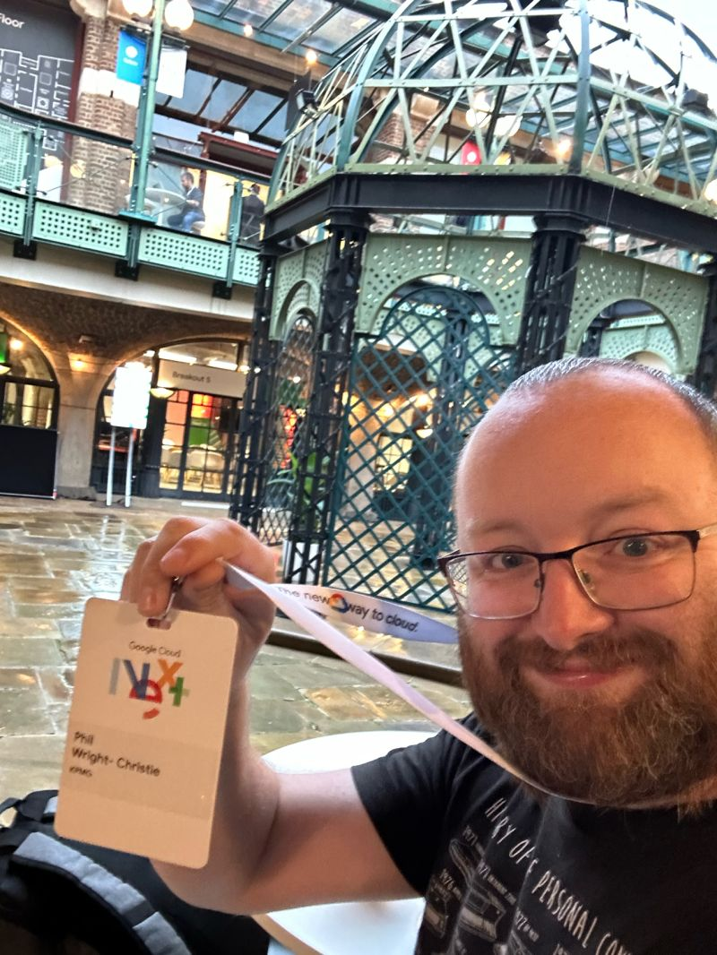
Lessons from the Technical Lead for KPMG AVA
AI is Still Software - Treat GenAI like any complex software project: robust SDLC, CI/CD, automated testing, and multidisciplinary teams are critical.
2. Governance is Essential - AI without policies risks misuse. Embed clear rules, educate stakeholders, and enforce responsible use.
3. Security First - AI thrives on data—protect it. Use secure-by-default configurations, access controls, and strict data segregation.
4. Augment, Don’t Replace - Use the “80/20” rule: AI handles 80% of work, humans apply judgment to the final 20% for quality and ethics.
5. AI is a Tool, Not a Replacement - Use AI to supercharge—not replace—domain-specific tools (e.g., DMS, reporting), enhancing insight and responsiveness.
6. Tangible ROI - AVA saves 14+ hours/month per user and shortens project timelines. Clear productivity and value gains.
7. Process Clarity is Key - AI needs clear, well-documented workflows to automate effectively. This also strengthens overall process governance.
8. AI + Humans = Success - AI is not magic. It succeeds when paired with domain knowledge, creativity, and collaboration.
9. Design for Change - The AI landscape evolves fast. Prioritize configurability to adopt new models and features swiftly.
10. Adoption Requires Support - Build it and support it: documentation, training, and user engagement are essential to drive uptake.
Phil Wright-Christie
KPMG Cloud Capability Lead & AVA Technical Lead
Source (i.e. distilled from): https://medium.com/@philwc/ten-lessons-i-learned-developing-ava-kpmg-uks-flagship-genai-as-a-service-platform-75e4644d282c

Slide 45
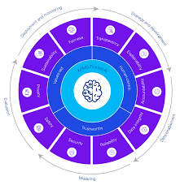
KPMG’s “Trusted AI” Framework
KPMG's Trusted AI framework is a comprehensive strategy designed to ensure that artificial intelligence (AI) technologies are developed, deployed, and managed responsibly and ethically.
Core Principles
KPMG's approach to Trusted AI is guided by three foundational principles:
Values-Driven: AI initiatives are aligned with KPMG's core values, promoting a culture that is open, inclusive, and adheres to the highest ethical standards.
Human-Centric: The framework emphasizes the importance of human impact, aiming to empower and augment human capabilities rather than replace them.
Trustworthy: KPMG commits to maintaining ethical standards in data acquisition, governance, and usage, ensuring compliance with privacy and data protection regulations.
Ethical Pillars
To operationalize these principles, KPMG has established ten ethical pillars that guide the responsible use of AI:
Fairness: Designing AI systems to minimize bias against individuals or groups.
Transparency: Ensuring AI processes and decisions are understandable and communicated clearly.
Explainability: Developing AI solutions that can articulate how and why decisions are made.
Accountability: Embedding human oversight throughout the AI lifecycle to manage risks and ensure compliance.
Data Integrity: Acquiring and using data that is accurate, complete, and appropriate for driving trustworthy decisions.
Reliability: Ensuring AI systems operate consistently within their intended scope and precision.
Security: Implementing robust measures to protect AI systems from malicious activities and misinformation.
Safety: Designing AI to prevent harm to individuals, businesses, and property.
Privacy: Complying with relevant privacy and data protection laws in AI design and implementation.
Sustainability: Creating AI solutions that are energy-efficient and environmentally friendly.
Governance and Implementation
KPMG's Trusted AI framework is supported by a structured governance model that involves:
Leadership Engagement: Senior leadership, including the board and C-suite, are responsible for setting AI strategies, defining risk appetites, and ensuring alignment with business goals.
Policy Development: Establishing comprehensive policies and standards around AI design and usage, focusing on ethical principles and data lifecycle management.
Risk Management: Implementing protocols to assess and mitigate risks associated with AI, including privacy, security, and compliance concerns.
Data Governance: Ensuring data quality, security, and ethical use throughout the AI lifecycle.
Cross-Functional Collaboration: Encouraging collaboration among AI developers, data scientists, legal, and business teams to address multifaceted AI challenges.
Continuous Evaluation: Regularly assessing the effectiveness of AI management systems and making necessary improvements to align with evolving regulations and standards.
By integrating these principles and pillars, KPMG's Trusted AI framework aims to foster responsible AI adoption, ensuring that AI technologies are used ethically and effectively to drive innovation and value.
Source: KPMG

Slide 46

Case: PairD at Deloitte, a UK Developed GenAI Platform
“Our generative AI platform is part of long-term AI investment plans, as we continue to explore the potential that this technology could offer our firm, our clients and wider society,”
Costi Perricos
Global GenAI Business Leader
“It was brilliant to see so many teams from across the firm – those with expertise in AI technology, platforms, risk, legal, ethics, and data security and privacy – rally behind this common goal. With a lot of grit and determination, we were able to develop a solution that met our exacting standards for ethical and secure GenAI use within the firm.”
Sulabh Soral
Chief AI Officer, Consulting

Slide 47

Case: PWC
On increased spending on AI technologies…. “I could see pretty quickly [early on] that the money we were going to need to spend on technology , and AI in particular, needed to go up. We were going to need to spend more than we’ve ever spent before.” On the role of PWC in the AI wave…..
“We know what this stuff can do and what it can’t do. We know more about that than Meta does, or any of the tech people. If I’ve got a client who needs to manage their fleet of cars better … what I’m looking for is an AI-based solution to that challenge. Meta won’t give them that.”
Marco Amitrano, PWC EMEA CEO
Source: Sunday Times, June 15, 2025.

Slide 48

Case: Accenture
“We are writing the playbook for how to be the most AI-enabled, client-focused professional services company in the world and a great place to work for our people - our reinventors.”
Bringing all its service (incl. consultancy) together into a single, integrated unit called “Reinvention Services” - to create more leading solutions faster and embed data and AI more easily into its solutions and delivery
AI Refiner Distiller platform— addresses the full lifecycle: multi-agent orchestration, memory, workflows, governance, observability, cross-platform interoperability
Investing heavily in reskilling: rolling out AI / agentic AI training programs across its workforce.
Generative AI new bookings of $1.8 billion for the quarter and $5.9 billion for the year
Chair & CEO, Julie Sweet

Slide 49


Case: Unity Advisory (Challenging General Consulting)
$300m in funding
Aims to be “leaner, conflict-free and offer AI embedded performance-led models to clients.”
Targeting clients with between £500m to £1.5 bn
Marissa Thomas, Former COO of PWC & CEO of UA
“CFOs are open to a new proposition. The Big Four are a classy bunch of service providers, but people are looking for a proposition that is super client-centric, has really low administrative cost, is AI-led rather than based on legacy infrastructure and, crucially, has no conflicts.”
Steve Varley, Former UK Chair of EY & Chair of UA
Source: Consultancy.uk 29 April, 2025.

Slide 50

Case: Dstyl (Focused on AI Consulting)
Founded in 2022 from employees of Palantir where they served in senior business development roles for over 5 years (Cornell & Wharton grads)
HQ in San Francisco
Approx. 100 employees, around $30m of revenues growing at 5x in 2024 and 8x in 2025
Raised $175 million, giving it a valuation (reported) of ~$1.8 billion
Closing the “last mile” of AI adoption (integration, embedding, operations) that many tool vendors don’t address
Founders: Arjun Prakash and Derek Ho formerly in senior business development roles at Palantir
“Our belief is that the next chapter of AI leadership won’t be won by the models alone, but by operationalizing AI at scale in enterprises and transforming how they work.”

Slide 51

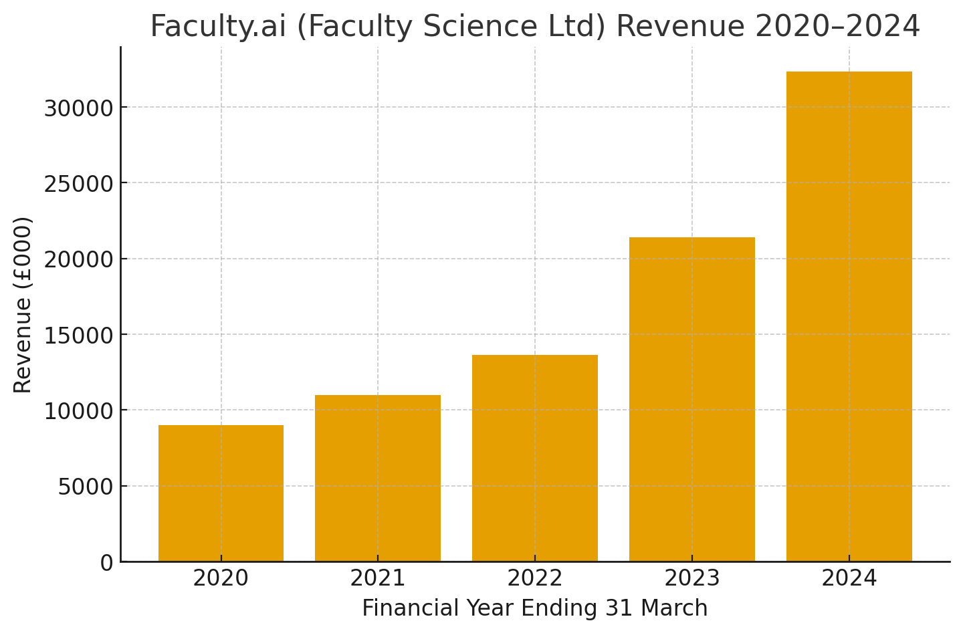
Case: Faculty AI (Focused on Applied AI – Consulting, Applications & Platform specializing in Frontier AI)
Founded by Marc Warner, Angie Ma and Andy Brookes in 2014

Slide 52

Case: Echelon AI – (Automating Implementation of Enterprise Software Application, ServiceNow)
"The biggest barrier to digital transformation isn't technology — it's the time it takes to implement it ….. AI agents are eliminating that constraint entirely, allowing enterprises to experiment, iterate, and deploy platform changes with unprecedented speed."
Echelon's approach replaces human consultants with AI agents trained by elite ServiceNow experts from top consulting firms. These agents can analyse business requirements, ask clarifying questions in real-time, and automatically generate complete ServiceNow configurations including forms, workflows, testing scenarios, and documentation.
Rahul Kayala – Co Founder, Echelon AI
$4.75 million in seed funding led by Bain Capital Ventures
https://www.echelonai.com

Slide 53
Participants’ Exercise
OK who will admit to considering their own “challenger” play! ☺ … only kidding ☺

Slide 54
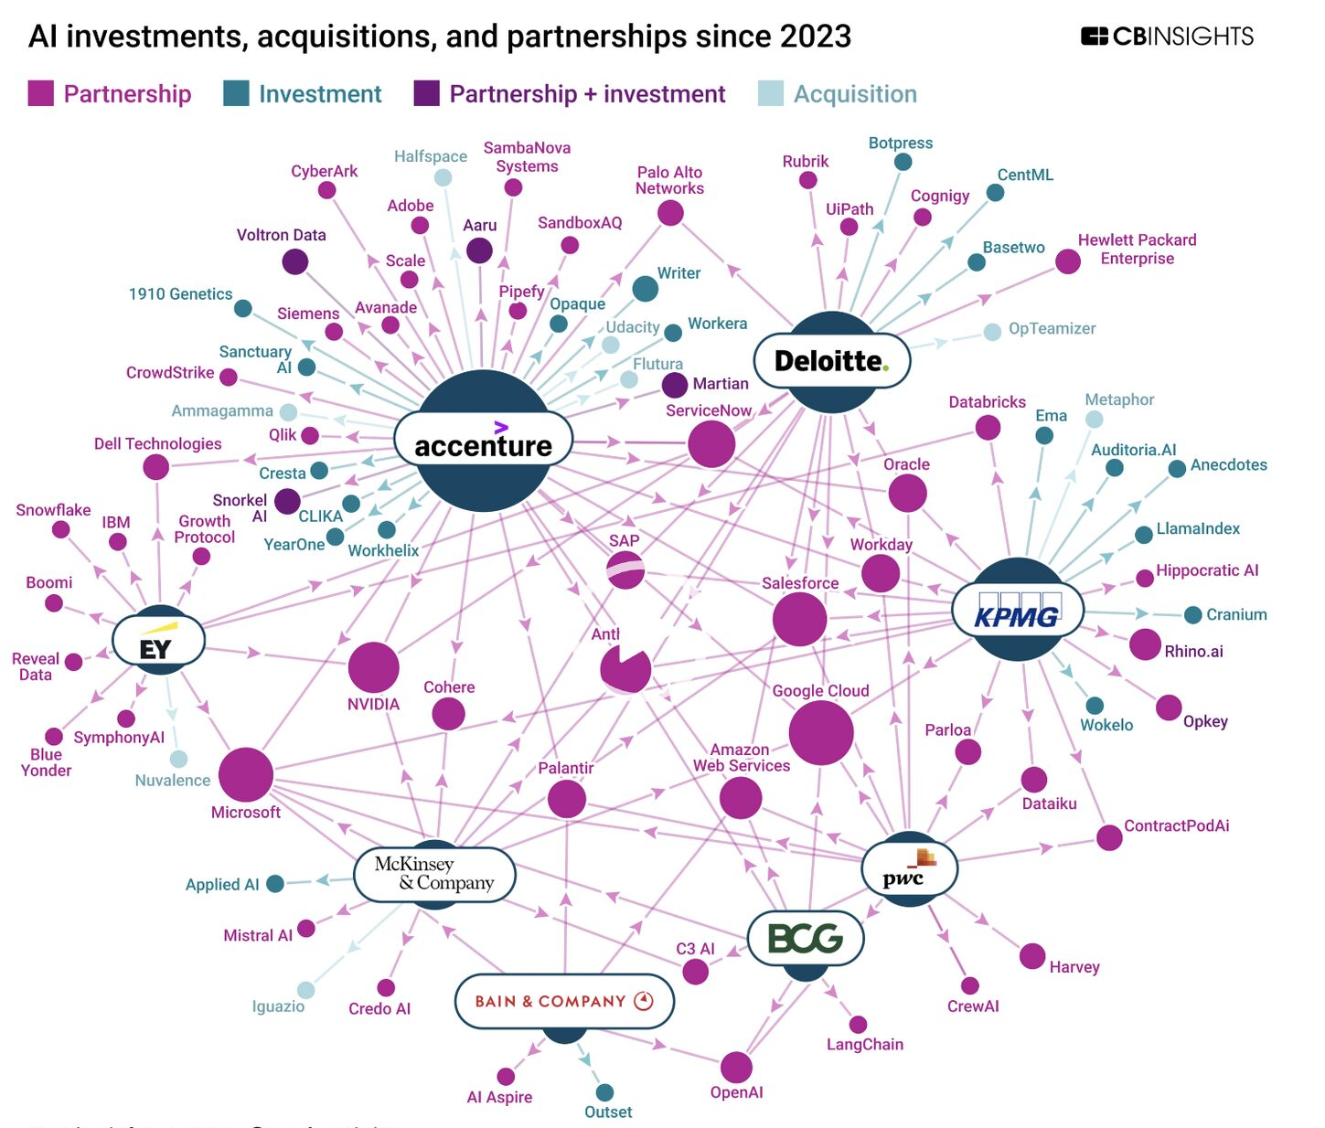
© CBInsights Source: https://www.linkedin.com/posts/hugoraaijmakers_ai-agents-are-reshaping-consulting-faster-activity-7379775982997757952-o7Mb/?utm_source=share&utm_medium=member_ios&rcm=ACoAAAAHVlcBM9XTwIsp2Pvb1QCQ-7A1hJdMnGM
Notes:
According to
CB Insights data, consultancies have been making significant investments in AI through acquisitions, partnerships, and internal development. The focus has been on integrating AI to streamline internal processes, launch AI-powered products, and provide enhanced solutions for their clients.
AI investments and strategies by top consultancies
Accenture
Acquisitions: Has acquired numerous AI startups, including Industrial AI company Flutura, to deepen its capabilities.
Strategic partnerships: Is highly active, with key collaborations involving major tech companies like Microsoft, NVIDIA, and Anthropic.
Product development: Launched the "AI Refinery" platform in 2024–2025 to evolve from custom consulting to scalable AI solutions.
Restructuring: Merged five business units into a new "reinvention services" line to help clients restructure their operations with AI.
Deloitte
Internal tools: The Deloitte AI Institute launched an internal generative AI copilot in January 2024 for tasks like coding and project planning.
Product development: Offers "Zora AI," one of many AI agent platforms launched by major firms.Strategic partnerships: Has formed alliances with AI-focused tech firms like Databricks and ServiceNow.
KPMG
Acquisitions: Acquired data infrastructure company Metaphor to strengthen its data management capabilities.
Investments: Invested in LlamaIndex, which focuses on data management, to enhance its AI tools.
Strategic partnerships: Is partnering with emerging AI startups, including Hippocratic AI.
PricewaterhouseCoopers (PwC)
Investments: Invested in AI tools such as Harvey to integrate advanced AI capabilities.
McKinsey & Company
Internal development: Deployed an internal AI assistant, Lilli, to assist consultants. It is now used by over 72% of its workforce, significantly improving research efficiency.
Proprietary tools: The development of tools like Lilli has led to leaner, more senior-heavy project teams as AI handles routine tasks.
Acquisition: Acquired AI company QuantumBlack to expand its analytics capabilities.
Boston Consulting Group (BCG)
Internal development: Developed the AI tool "Deckster" to create presentation decks in minutes.
Strategic partnerships: Partnered with large language model developer Anthropic to focus on responsible AI.
Bain & Company
Internal development: Deployed "Sage," an AI copilot trained on its internal intellectual property.
Ernst & Young (EY)
Product development: Launched its "Agentic Platform" as part of the trend toward AI-agent-based services.
Key trends in consultancy AI investment
Move to scalable products: Rather than solely providing customized consulting, firms are developing scalable, product-based AI solutions and new pricing models to deliver value.
AI agent platforms: The major firms launched AI agent platforms in 2024–2025 to enable a transition toward a human-AI workforce.
Focus on partnerships and acquisitions: The professional services sector has engaged in more than 100 AI agent-related partnerships, investments, and acquisitions since 2023.
Acquiring infrastructure: Firms are acquiring data infrastructure companies to strengthen their ability to manage and utilize data, an essential step for building robust AI capabilities.
Reshaping the workforce: As AI handles routine tasks, the traditional consulting model is shifting toward more senior-heavy teams.

Slide 55
Insights: AI Developments across Consulting Industry
Consultancy Industry | Gathering pace and investing in platforms, people and propositions Senior level leadership with some restructuring happening Early days for benefits from AI deployed within consultancy processes Rapid growth in new business supporting clients in their AI journeys Recruitment and retention being affected & investing in training Different ways for solving the issue of needing an AI platform
Strategy houses & boutiques | Early mover advantages have yielded impressive results Partnering for AI technology platforms Able to leverage their internal data and knowledge bases
Big-4 & IT Services consultancies | Early moves do not seem to have paid off, but moving at pace now Building their own comprehensive AI technology platforms (not yet with own foundation models) Rapidly growing revenue on corporate agentic AI Restructuring & AI platform investments pressuring earnings
Challengers | Surprisingly, so far only a few and not a major feature VC funding available and first movers are gaining traction Less “challenging the incumbents” than “riding the wave”

Slide 56
Insights: AI Services for Clients’ AI Transformations
Innovative
Strategic
Services that are new, disruptive, differentiate the consultancy and generate new business models or capabilities—not just incremental improvement. They are higher risk, higher reward.
Services that are critical to building the consultancy’s core future growth, or positioning them in the market, or shifting their business model—but maybe less novel. They help the consultancy’s brand, alliances, capabilities, and growth pipeline.
• Agentic AI / autonomous-agent development • Generative AI products / asset creation • Industry-/domain-specific next-gen AI solutions • AI strategy & new business-model re-thinking
• AI / Gen-AI strategy & roadmap development • Data & tech readiness / AI-foundation building • Governance, ethics, assurance and risk frameworks • Talent, change management, people & culture • Compliance/regulatory AI audit services
High
Developing future business
Supportive
Operational
Services that are required (or soon will be) but are relatively mundane, commoditised, perhaps low margin, and unlikely to build new business or major differentiation.
Services that are important and often must be done for AI programmes to work but are less likely to create new strategic advantage for the consultancy (and may provide lower margins). They often support the journey rather than lead.
Low
• Back-office, shared-services automation via AI • Basic training/up-skilling of workforce for AI literacy • Basic infrastructure set-up (if standardised) • Routine compliance reporting for AI (as baseline)
• Use-case identification & prioritisation • Implementation/roll-out of generative AI • Performance monitoring, model maintenance • Operational automation / efficiency gains
Low
High
Developing current business

Slide 57
Generative & Agentic AI for Consulting
Naïve Prompting LLM + UI
Prompt Engineering LLM + Prompt + UI
Augmentation LLM + RAG + Prompt + UI
Agentic AI LLM + RAG + Agents + Memory + MCP + Prompt + UI
Autonomous Agents LLM + RAG + Agents + MCP + Prompt + UI + Autonomy
Consultants asking questions or requesting actions from a ChatGPT – both on firm’s platform or as “shadow AI” on their personal GPT accounts
Outputs from a ChatGPT can be improved significantly with context and prompt engineering introduced to the LLM via the LLM’s context window
The LLM can be fine tuned for specialist tasks or specialist knowledge introduced using RAG for the LLM to use that knowledge in its responses
Specialised agents (often by role) can be created that work together under an orchestrating agent to carry out a series of specialist AI-enabled tasks to achieved a complex goal
The AI application can be allowed to operate autonomously – with humans in the loop or (potentially) without!

Slide 58
Live Demo 2 | Co-Worker

Slide 59



Demo: AI Enabled Consultancy Co-Worker (1)
Idea: I am a practicing consultant in a consultancy. My expertise is not in AI but given the demand for AI advice from clients a “Co-Worker” with both consultancy expertise and AI strategy expertise would be helpful. HR say recruiting such a person is impossible. Can Agentic AI be used instead.
Scenario: We have a meeting with the CEO of the BCS to discuss its AI strategy. Can the AI Co-Worker create a briefing pack, plan to support the BCS, engaging email and a slide deck?

Slide 60
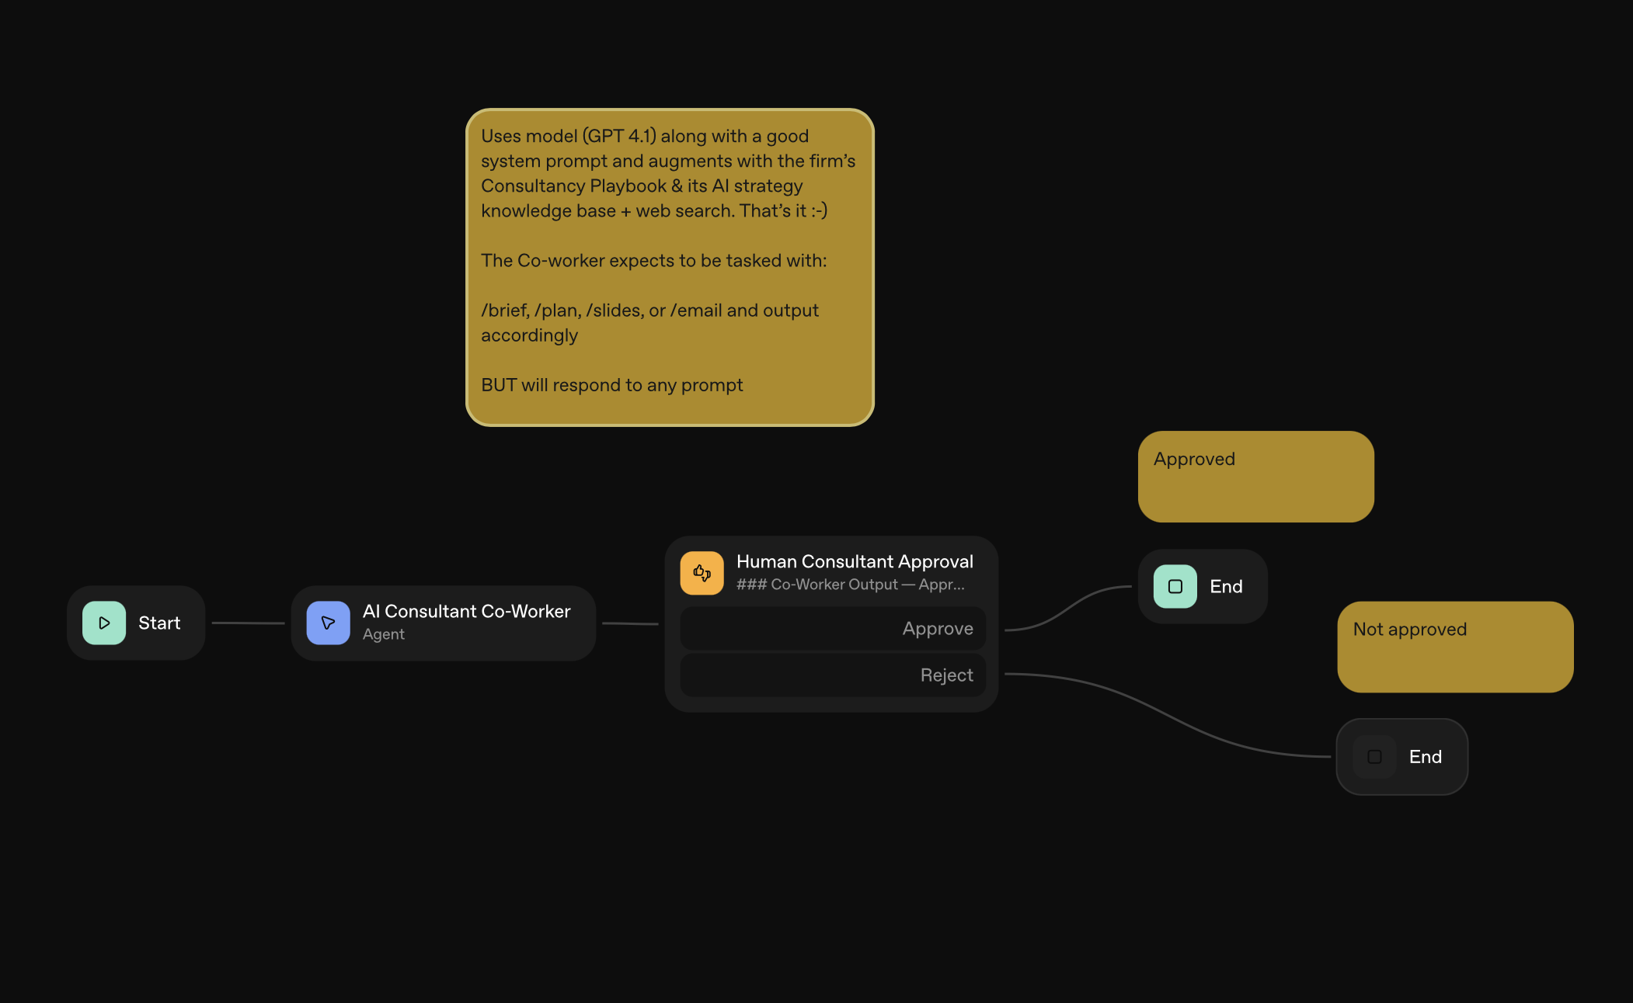
Demo: AI Enabled Consultancy Co-Worker (2)

Slide 61
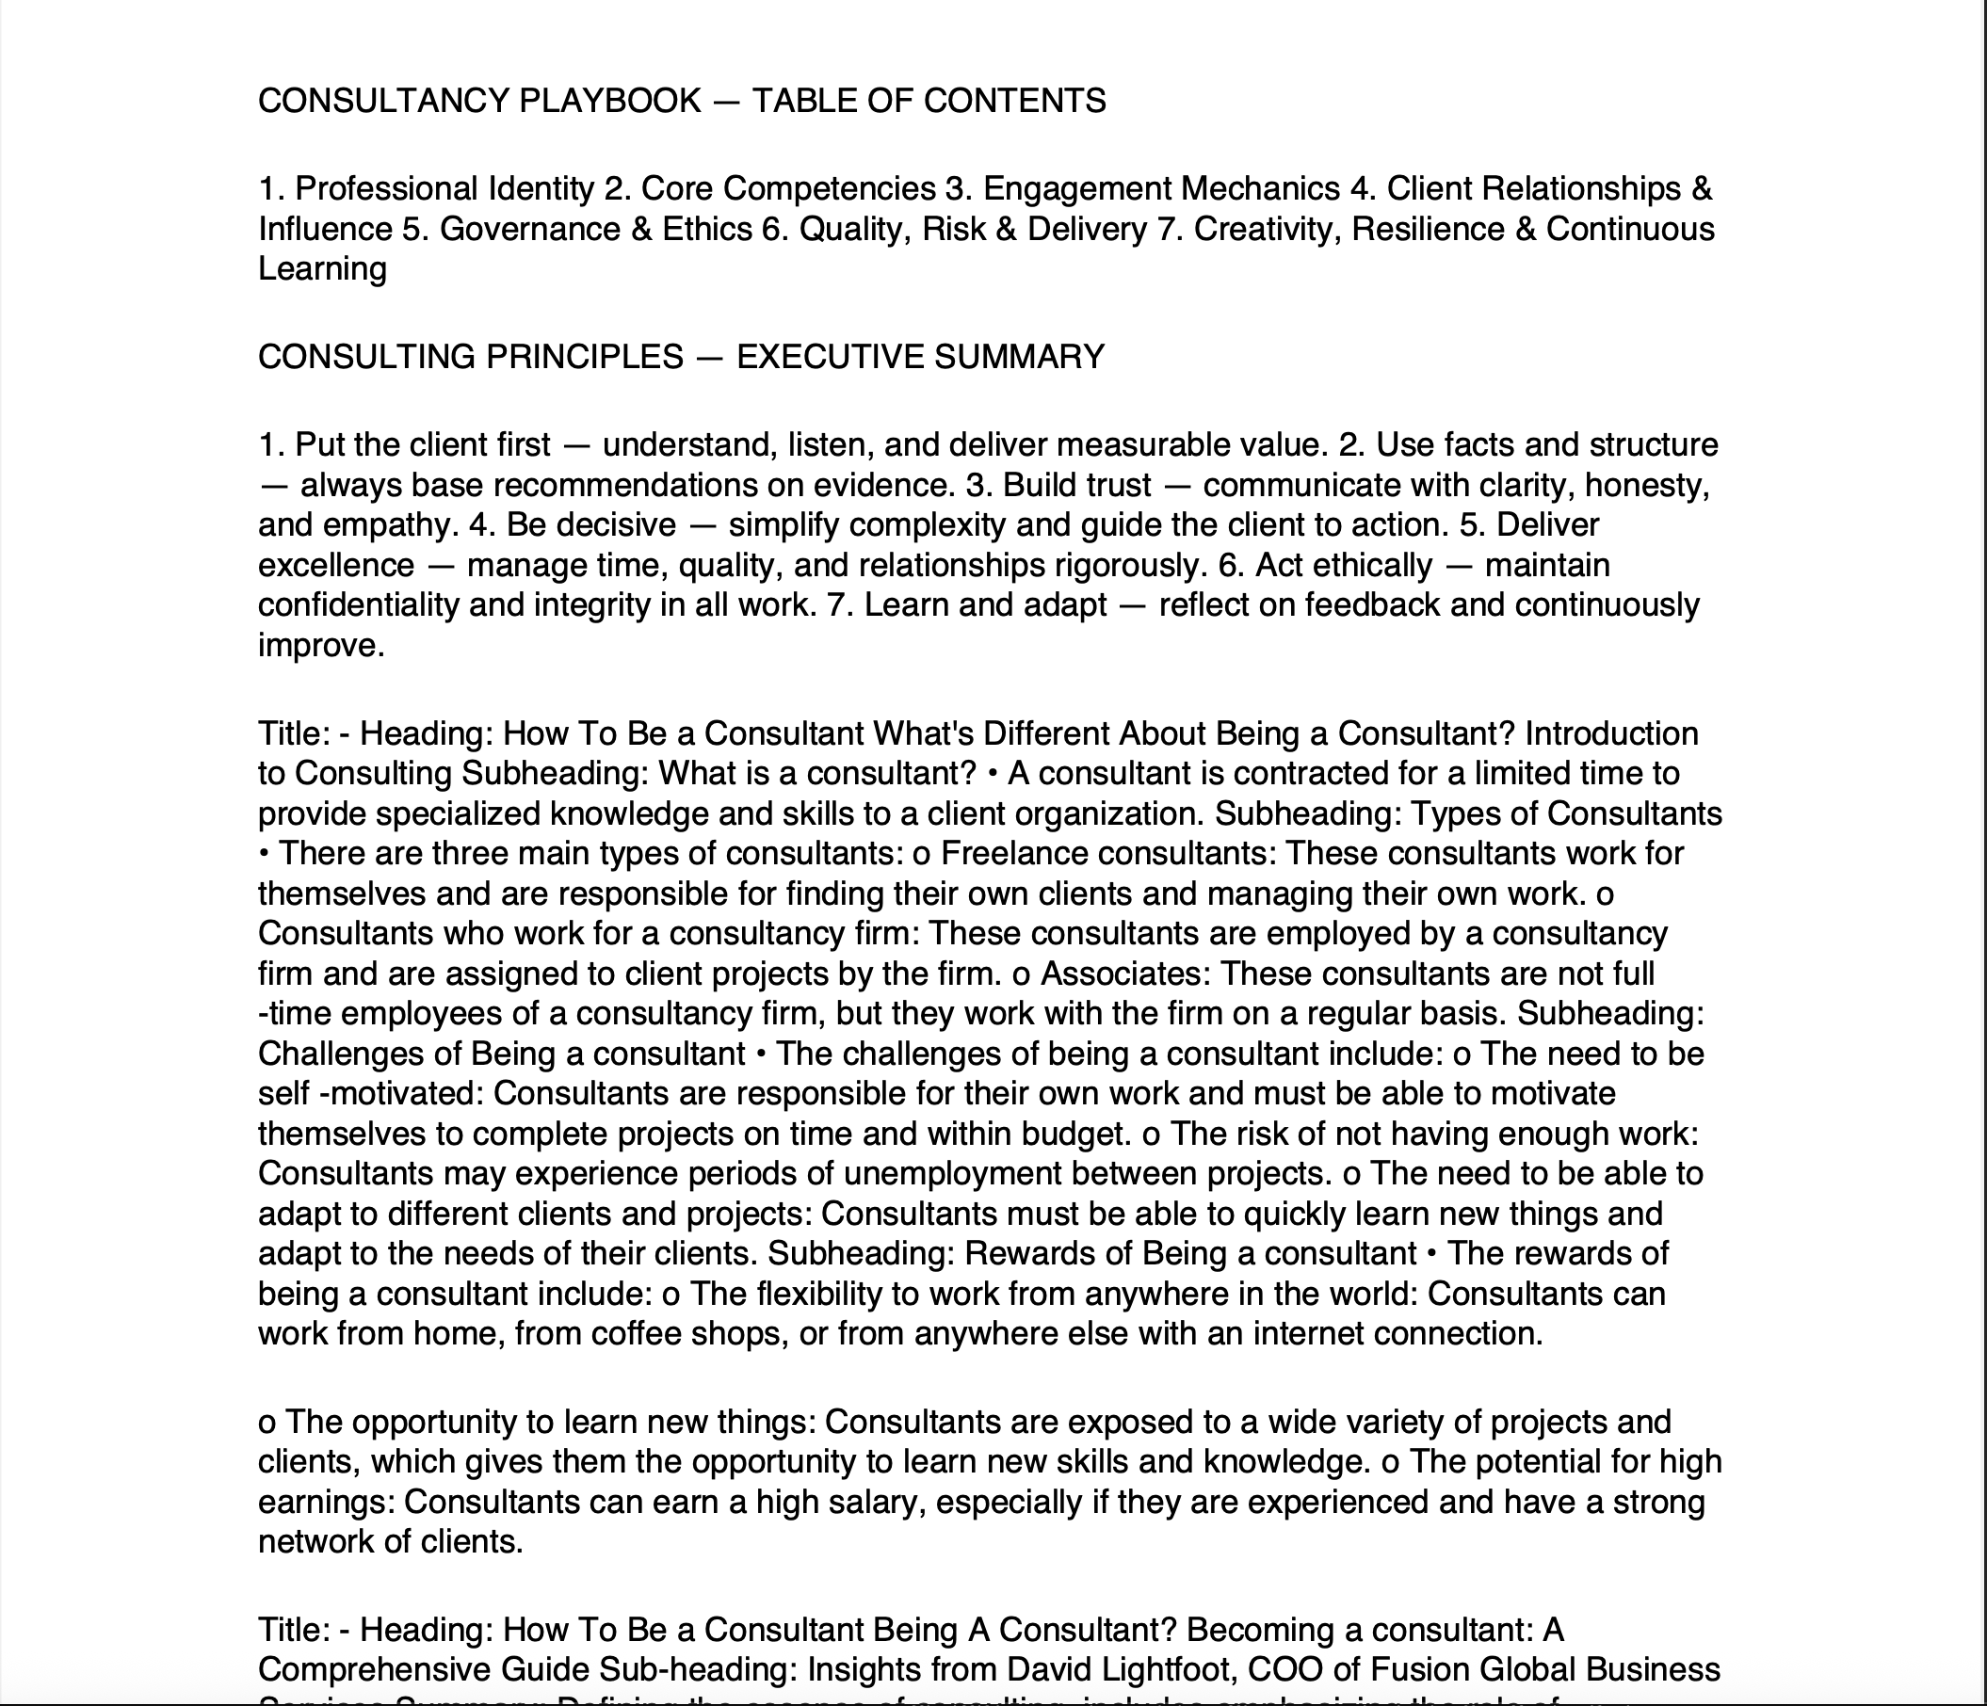
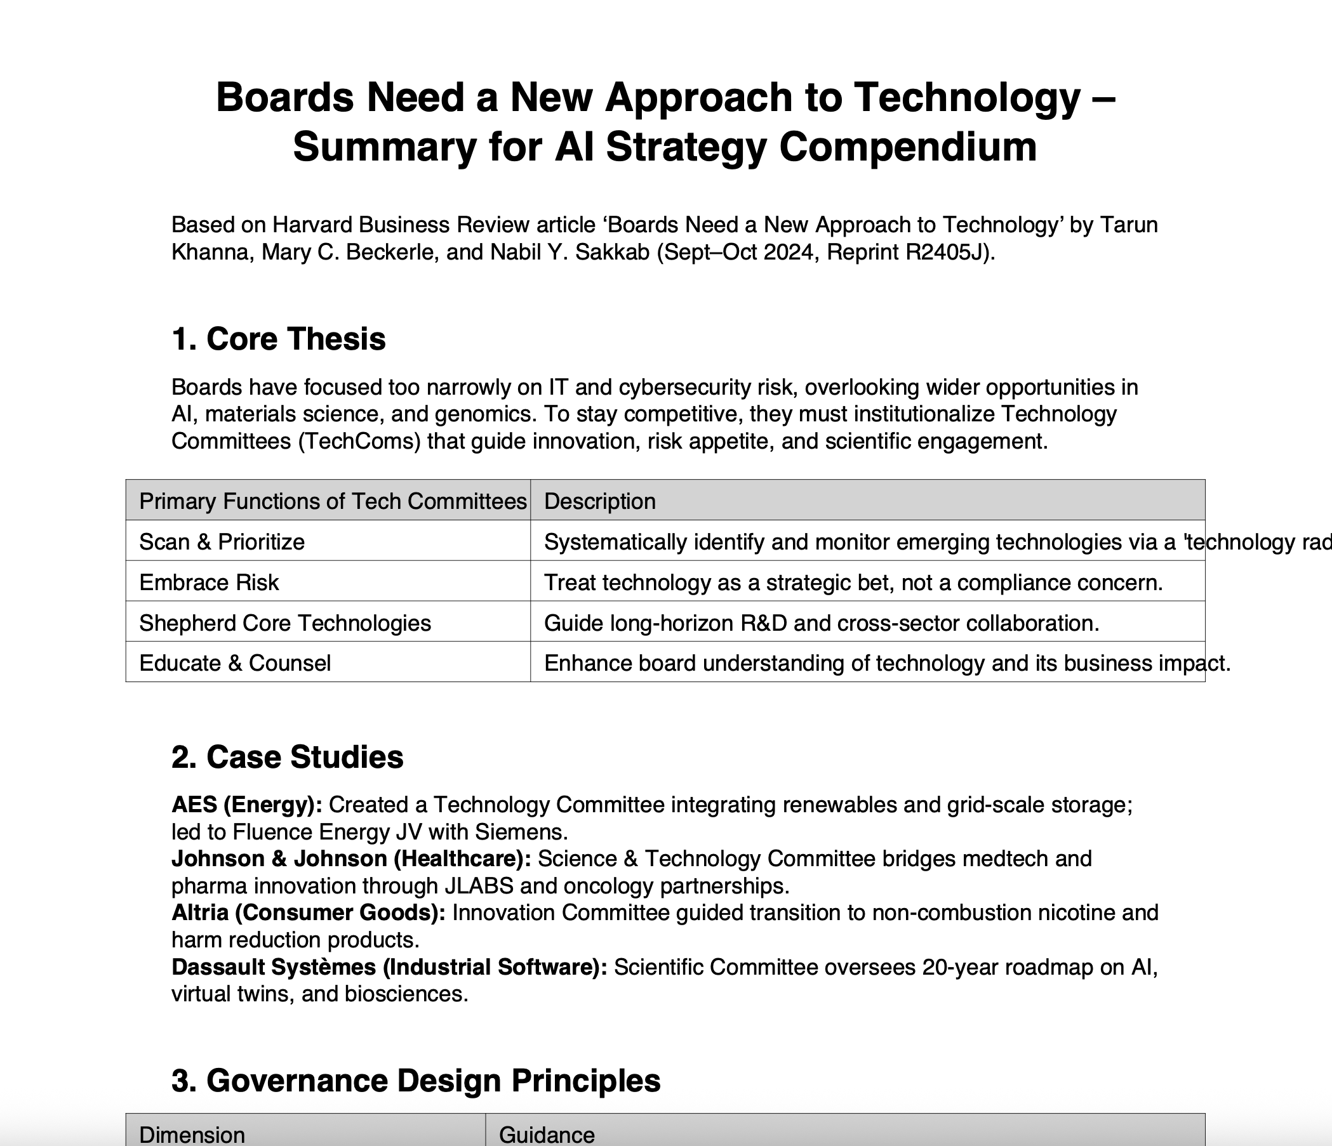
Demo: AI Enabled Consultancy Co-Worker (3)
Consultancy Playbook
(increased knowledge of consulting)
AI Strategy Compendium
(increased knowledge of AI in business)

Slide 62




Demo: AI Enabled Consultancy Co-Worker (4)
/brief. We have a meeting with the Chief Executive of the British Computer Society to discuss the Society's AI strategy. Prepare a briefing paper on the British Computer Society and propose AI strategies it should be considering.
/plan. Create a plan that we can discuss with the Chief Executive for creating and implementing an AI strategy for the Society with support from consultancy.
/email. Draft an email to the Chief Executive thanking her agree to the forthcoming meeting and outlining what should be discussed.
/slides. Create the slides for the meeting.

Slide 63
Demo: AI Enabled Consultancy Co-Worker (5)
Briefing:
British Computer Society (BCS) is the UK’s Chartered Institute for IT, founded in 1957 and granted its Royal Charter in 1984. It promotes computing education, professional standards, chartered status (CITP, CEng), ethics, and diversity for public benefit wikipedia.org(en.wikipedia.org).
BCS currently serves ~70,000 members across 150 countries, anchored on four strategic pillars — Membership, Inspiration, Progression, Influence — with a sharp focus on ethics, skills, education, and public trust in technology bcs.org(bcs.org).
Recommended AI strategy directions:
• Establish an AI Ethics Framework and Professional Accreditation: Build on BCS’s ethical mandate to define standards or a charter for ethical AI. Offer specialist accreditation (e.g. CITP-AI), reinforcing accountability and trust bcs.org(bcs.org). • Embed AI into Education & Skills: Develop AI learning paths within school (Inspiration) and professional development frameworks (Progression). Align with digital literacy and diversity goals. • Advocate and Influence AI Policy: Use BCS’s Influence platform to shape public policy on AI regulation, governance and workforce readiness. • Foster Inclusive AI Communities: Launch specialist AI interest groups to accelerate peer learning, research translation, and ensure under‑represented groups are engaged in AI development.
Each initiative aligns with BCS’s charter, supports its strategic pillars, and strengthens its mission of “making IT good for society.”

Slide 64
Demo: AI Enabled Consultancy Co-Worker (6)
1. Establish AI Strategy Taskforce
Owner: BCS Chief Executive, Consulting Lead
Timeline: Month 1
Outcome: Cross-functional team (internal/external) formed to steer AI strategy.
2. Define Strategic Vision & Stakeholder Needs
Owner: Taskforce, Consulting Team
Timeline: Months 1-2
Outcome: Vision statement, mapped stakeholder requirements (members, educators, industry, policymakers).
3. Assess Current Capabilities & Gaps
Owner: Consultants, BCS Department Heads
Timeline: Months 2-3
Outcome: SWOT analysis, readiness assessment for people, technology, governance, and ethics.
4. Develop AI Ethics & Accreditation Framework
Owner: Ethics Board, Consultants
Timeline: Months 3-5
Outcome: Draft ethics framework; roadmap for new AI professional accreditations..
5. Launch AI Education & Skills Initiatives
Owner: BCS Education & Membership Teams
Timeline: Months 4-7
Outcome: School outreach, new AI learning paths, member upskilling programmes.
6. Policy Advocacy & Public Engagement
Owner: Policy/PR Lead, CEO
Timeline: Months 3-8
Outcome: Published AI policy position; engagement forums for members and public.
7. Pilot Specialist AI Communities & Partnerships
Owner: Membership, Community Manager
Timeline: Months 6-8
Outcome: AI special interest groups, partnerships with universities, industry, and diversity groups.
8. Implementation, Monitoring, and Review
Owner: Taskforce, Consultants
Timeline: Months 8-12
Outcome: Execution tracked via KPIs, bi-annual review; iterative improvement.

Slide 65
Demo: AI Enabled Consultancy Co-Worker (7)
Subject: Agenda for Forthcoming Meeting on BCS AI Strategy
Dear [Chief Executive’s Name],
Thank you for agreeing to meet with us to discuss the British Computer Society’s approach to AI. We value this opportunity and look forward to collaborating on next steps.
To ensure our conversation is productive, we propose the following agenda:
The Society’s strategic vision for AI and desired outcomes
Considerations for establishing an AI strategy taskforce
Assessing current strengths, gaps, and readiness for AI adoption
Opportunities to develop AI ethics standards and professional accreditation
Expanding AI education and skills initiatives across membership and outreach
Shaping BCS’s role in AI policy advocacy and stakeholder engagement
Piloting new specialist AI communities and external partnerships
Agreeing next steps, support required, and success metrics
We welcome your input on additional topics to cover. Please let us know if the agenda aligns with your expectations or if there are priority areas to highlight.
We look forward to our discussion.
Best regards,
[Your Name] [Your Position] [Your Consultancy]

Slide 66
Demo: AI Enabled Consultancy Co-Worker (8)
Slide 1: Meeting Purpose & Agenda
Welcome and introduction
Purpose: Outline and co-develop BCS’s AI strategy directions
Key topics: Vision, taskforce, ethics, skills, advocacy, next steps Suggested Table: Meeting agenda overview
Slide 6: Ethics Framework & Professional Accreditation
Develop BCS-led AI ethics framework
Integrate into updated professional standards & certifications
Enhance public trust in AI practitioners Suggested Flow: Ethics—>Standards—>Accreditation
Slide 2: BCS—AI Strategic Imperative
BCS: Charter to advance ethical, impactful technology for public benefit
AI’s rising influence in society, industry, and policy
Opportunity: Position BCS as a leader in responsible AI Suggested Chart: BCS mission → AI opportunity alignment
Slide 7: AI Education & Skills Initiatives
Embed AI content in school outreach, member upskilling, CPD
Diversity, equity, and inclusion at the core
Engage industry partners for practical learning Suggested Chart: Learning pathways
Slide 3: Vision & Outcomes for AI Strateg
Set an inspiring but pragmatic vision for AI at BCS
Target outcomes: Ethical leadership, member value, societal benefit
Align with BCS pillars: Membership, Inspiration, Progression, Influence Suggested Diagram: Vision/outcomes mapped to BCS pillars
Slide 8: AI Policy Advocacy & Community Building
Shape AI regulation and workforce policy
Convene forums, working groups, and public engagement
Launch specialist AI interest groups and partnerships Suggested Chart: Stakeholder engagement map
Slide 4: Proposed AI Strategy Taskforce
Cross-functional team (internal + external expertise)
Accountable for strategy formulation, implementation, monitoring
Ensures inclusivity: members, educators, policymakers Suggested Org Chart: Taskforce structure
Slide 9: Implementation Roadmap & Consultancy Support
Phased delivery plan with milestones and owners
KPIs, monitoring, and feedback loops
Consultancy as strategic partner from design to execution Suggested Timeline: 12-month roadmap
Slide 5: Assessing Readiness & Identifying Gaps
Review current skills, processes, governance, and technology
SWOT analysis to inform priorities
Leverage consultancy for independent assessment Suggested Table: Example SWOT elements
Slide 10: Discussion & Next Steps
Confirm alignment on approach and priorities
Gather feedback and additional focus areas
Agree immediate next steps and meeting schedule Suggested Table: Action items & owners

Slide 67
Live Demo 3 | AI Enabled Consulting Team

Slide 68
Enterprise Vibe Consulting Demo (1) Scenario: UK grocery chain’s online conversion dropped 8% in Q3. Identify drivers and propose actions within 4 weeks.
Intake & Scoping Account Director
Review Scope (Human in the Loop) Consulting Director
Research Researcher
Analysis (incl. client datasets) Analyst
Strategy Consultant
Project Design Managing Consultant
QA & Ethics Review Senior Consultant
QA Sign Off (Human in the Loop) Consulting Director
Editing Client Docs Senior Consultant
Review & Approval
(Human in the Loop)
Consulting Director

Slide 69
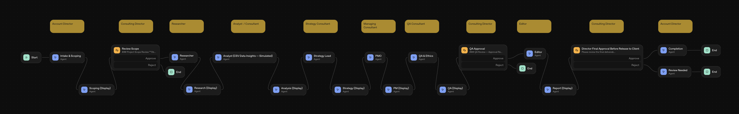
Enterprise Vibe Consulting Demo (2)
OpenAI Agent Builder Platform To run quickly uses GPT 4.1, little prompt engineering beyond role, low number of tokens Human in loop restricted to stage approvals. Data is simplified.

Slide 70
Enterprise Vibe Consulting Demo (3)
Intake & Scoping Account Director
Research Researcher
Objectives
Identify the key drivers of the 8% drop in online conversion in Q3
Propose actionable recommendations to restore or improve the online conversion rate
Complete the analysis and deliver recommendations within 4 weeks
KPIs
Identification of top drivers contributing to the conversion decline
Delivery of comprehensive driver analysis and action plan by 4-week deadline
Quantitative estimation of expected impact for each proposed action
Hypotheses
Technical issues or website changes negatively affected user experience
Changes in product mix, pricing, or promotions impacted conversion rates
Increased competition or market conditions influenced customer behavior
Operational/logistics factors (e.g., delivery slots, stockouts) contributed to drop
Economic factors or seasonality skewed shopping patterns in Q3
Claims and Supporting Evidence
UK grocery eCommerce conversion rate benchmark in 2024 was approximately 6.0%.
Supporting Quote: "The UK grocery eCommerce conversion rate was reported at 6.0% in 2024, indicating the typical baseline for online purchase completion."
Source
Mobile site performance significantly impacts conversion rates—62% of consumers are less likely to convert after a poor mobile experience.
Supporting Quote: "When 62% of consumers are less likely to convert if they have a negative mobile site experience, ensuring that your site is quick and easy to load makes a significant improvement on your overall conversion rates."
Source
Many UK supermarkets are experiencing declines in organic traffic on both desktop and mobile, which reduces potential site visitors and conversion opportunities.
Supporting Quote: "Three supermarkets reported a drop in organic traffic on desktop, with Sainsbury’s flagging the biggest decrease (-6%). On mobile, 5 supermarkets saw a drop in organic traffic, with Sainsbury’s also reporting the biggest loss on this device (-15%)."
Source

Slide 71
Enterprise Vibe Consulting Demo (4)
Analysis (incl. client datasets) Analyst
Strategy Consultant
Analytical Findings
Conversions fell sharply (25%) from July to August, coinciding with the lowest in-stock rate (84%).
Conversion recovery in October parallels improved stock rates (up to 93%).
The largest session drop (17%) did not fully explain larger conversion falls (21%), highlighting an internal conversion issue.
Media spend is most efficient in Search; reallocating from Display (ROI 0.9) could boost performance.
External evidence: Stockouts, traffic quality, and mobile UX are material drivers of conversion declines in UK grocery.
Suggested Charts
Line chart: Product In-Stock Rate vs. Conversions over time
Dual-axis line/bar chart: Sessions & Conversions by Month
Bar chart: Media Spend vs. ROI by Channel
Scatter plot: In-Stock Rate vs. Conversion Rate
Benchmark comparison: Client Conversion Rate vs. UK market benchmark
Strategic Options
Accelerate resolution of inventory and stockout issues by enhancing supply chain visibility and improving purchasing forecasts.
Reallocate digital marketing spend toward higher-ROI channels (e.g., Search), while deprioritizing low-performing channels like Display to improve quality of traffic.
Conduct a rapid audit and optimization of the mobile user experience, addressing any pain points identified by user research and technical monitoring.
Recommendation
Prioritize fixing product availability issues immediately, as restoring in-stock rates has the most direct and proven impact on online conversion recovery.

Slide 72
Enterprise Vibe Consulting Demo (5)
Project Design Managing Consultant
QA & Ethics Review Senior Consultant
30/60/90-Day Action Plan
30 Days: Conduct a root cause analysis of the 8% online conversion drop, focusing on inventory, user experience, and traffic sources. Gather relevant data and consult stakeholders.
60 Days: Develop, prioritize, and document actionable recommendations. Pilot or implement rapid fixes for highest-impact drivers, such as product availability and mobile UX.
90 Days: Track early results from interventions, iterate recommendations, and finalize a roadmap for sustained conversion rate improvement.
Key Risks
Lack of timely access to accurate data may delay root cause identification and actionable insights.
Stakeholder resistance or lack of ownership may hinder rapid implementation of fixes.
Interventions focused on specific drivers (e.g., inventory) may overlook complementary issues like marketing channel effectiveness or technical performance.
QA Summary
All claims are well-supported by external benchmarks and market data specific to UK grocery eCommerce.
Internal consistency is maintained between findings, recommendations, and the action plan; inventory/stockouts are correctly identified as the primary driver, with secondary technical and marketing-dependent factors noted.
Ethical alignment: No recommendations or plans present compliance, reputational, or data ethics risks.
No unsupported or conflicting claims were found.
Risks are transparently listed and align with plan rationale, emphasizing data and stakeholder engagement.
Draft is clear, actionable, and client-ready, with immediate next steps and KPIs included.
Final Approval Statement
The analysis confirms that the online conversion decline is primarily driven by stockouts, with technical and marketing channel factors as secondary contributors. Immediate restoration of product availability is the lead recommendation, backed by direct correlation in the provided data. The 90-day plan emphasizes rapid root cause analysis, targeted interventions, and ongoing improvements, with key risks appropriately noted. The draft is clear, factual, and suitable for client delivery after editing.

Slide 73
Enterprise Vibe Consulting Demo (6)
Editing Client Docs Senior Consultant
Executive Summary
The analysis revealed that the 8% drop in online conversion for the UK grocery chain during Q3 was primarily attributed to a significant decrease in product availability (stockouts), with the lowest in-stock rates directly correlating to the sharpest fall in conversions. Secondary contributors included the efficiency of digital marketing channels and user experience issues—especially on mobile devices—echoed by UK-wide trends in grocery eCommerce.
To reverse the decline, immediate focus should be given to restoring product availability as data shows this delivers the most direct recovery in conversions. Complementary actions include reallocating marketing spend toward better-performing channels (notably Search) and rapidly auditing and improving the mobile user experience. A clear 90-day roadmap has been provided, addressing root causes through targeted interventions and sustained measurement, with key risks identified and mitigated through stakeholder engagement and an iterative, data-driven approach.
Slide Outline
Situation & Objective
8% Q3 online conversion drop: urgent root cause analysis and action needed within 4 weeks.
Key Findings
Stockouts drove conversion decline; secondary effects from traffic quality and mobile UX.
Data Deep Dive
In-stock rate & conversion chart; channel ROI data; external benchmarks.
Recommendations
Restore product availability; optimize marketing mix; improve mobile UX.
90-Day Action Plan
30: Analyze, 60: Pilot fixes, 90: Review & roadmap. Address data & stakeholder risks.
Impact & Next Steps
Expected outcomes, ROI, and monitoring for sustained conversion growth.

Slide 74

Future of Vibe Consulting
Sam Altman has stated that he and other tech CEOs have a betting pool for when the first one-person billion-dollar company will emerge, which he believes is now possible due to AI. He has also reportedly said that this company will be built by an individual using a laptop, internet, and AI agents.
Sam Altman, Founder OpenAI

Slide 75
Buzz Group Exercise
Share key actions for attendees, consultancies & our profession ?
If on Zoom: Contribute into the “Chat” area - reading and building on others.
If in room: Organise into convenient small groups. Check around you that no-one is left out. Discuss.
Please don’t share confidential information!

Slide 76
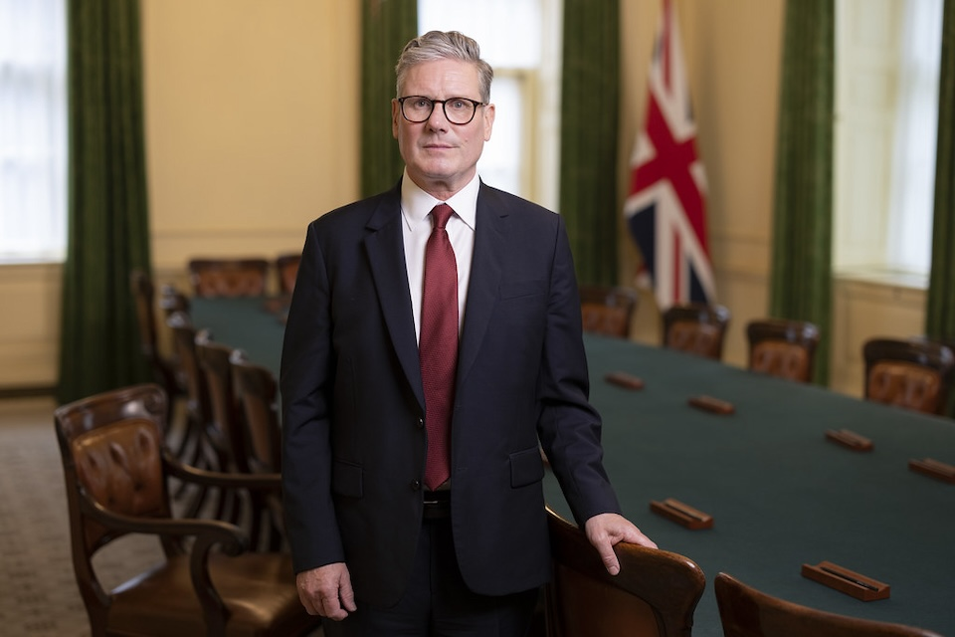
Vision: Golden Age for Consulting with Britain as an AI Consulting superpower
“And we are going to make AI work for everyone in our country…
This is the nation of Babbage, Lovelace and Turing…
That gave birth to the modern computer and the World Wide Web …
So, mark my words – Britain will be one of the great AI superpowers.
Now, that’s not boosterism or wishful thinking…
This can be done, and it will be done.”
Sir Kier Starmer, Prime Minister, UK (speech at UCL on 13/01/2025)

Slide 77
Anything BCS CONSIG should be doing for you?
Add ideas to the “ideas wall”
Or connect with us via Email:
mm.plc.consulting@googlemail.com
Or nab a Committee Member afterwards

Slide 78
Final Word from Nestor

Slide 79
Q&A / Contributions & Insights

Slide 80

Networking

